Slide 1
Applications of Gaussian Processes in Modelling Biological Collectives
Julia Klein, Master Thesis
Konstanz, 21.02.2020
Supervisors
Jun.-Prof. Dr. Tatjana Petrov
Dr. rer. nat. Matthias Rupp

Slide 2
Background
Modelling Biological Collectives
Stochastic models (Markov Chains, Chemical Reaction Networks) to model stochastic behaviour of biological populations
Individual behaviours represented by parameters of model
Formal verification to analyse properties and explore model
Problem: Uncertainties complicate execution of formal methods
Lack of data
Parametric models
Insufficient expert knowledge
State space explosion problem
11/24/2021
Applications of Gaussian Processes in Modelling Biological Collectives
Notes:
Complex mechanisms in biological systems usually modelled by simpler computer models, contain stochasticity
Model individual behaviours + interactions of agents
Formal verification: finally understand behaviours, explain observed phenomenon
Parametric models: still current research topic to find methods
Expert: not sure how to design model, uncertain parameters, not sure about properties of mechanism, etc.

Slide 3
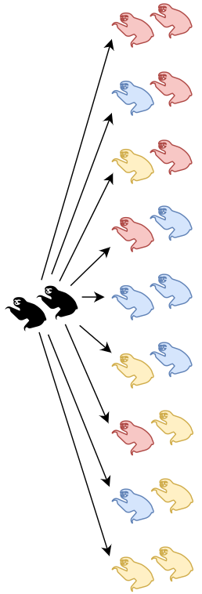
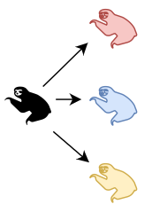
Background
Combinatorial Explosion
State space explosion problem in formal verification
…
3 possible states
9 possible states
3^{n} possible states
11/24/2021
Applications of Gaussian Processes in Modelling Biological Collectives
Notes:
All combinations are relevant -> individuals influence each other and interact

Slide 4
Background
Modelling Biological Collectives
Goal: Find method that is
flexible: widespread use
data-efficient: dealing with scarce data
scalable: analyses for larger colony sizes
Gaussian Processes
Innovative Bayesian approach in Machine Learning to learn unknown functions
Involves quantification of uncertainty
→ Combine formal verification with Gaussian Processes
11/24/2021
Applications of Gaussian Processes in Modelling Biological Collectives
Notes:
Flexible: applicable to different models with different assumptions
Data: for collectives often not much available
Scalable: where stochastic models quickly become too difficult

Slide 5
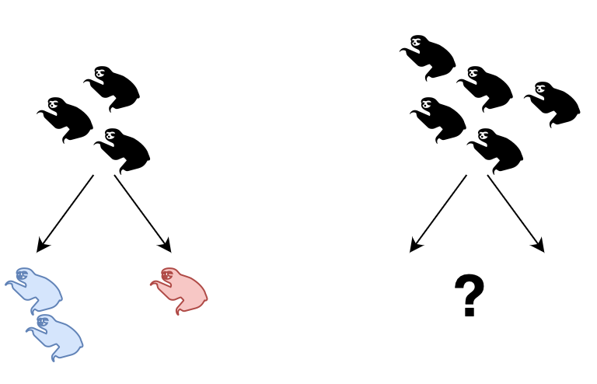
Research Questions
#1 What is the collective response?
→ Predict the behaviour of populations of different sizes
11/24/2021
Applications of Gaussian Processes in Modelling Biological Collectives

Slide 6
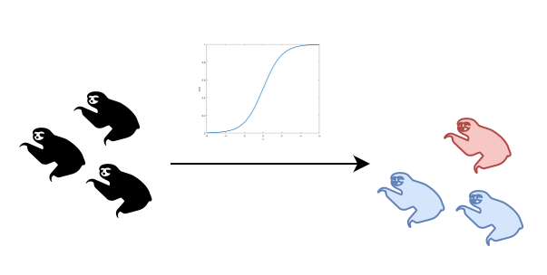
Research Questions
#2 What is the fitness function the collective tries to optimise?
→ Find a pattern of behavioural responses over populations of different sizes
11/24/2021
Applications of Gaussian Processes in Modelling Biological Collectives

Slide 7
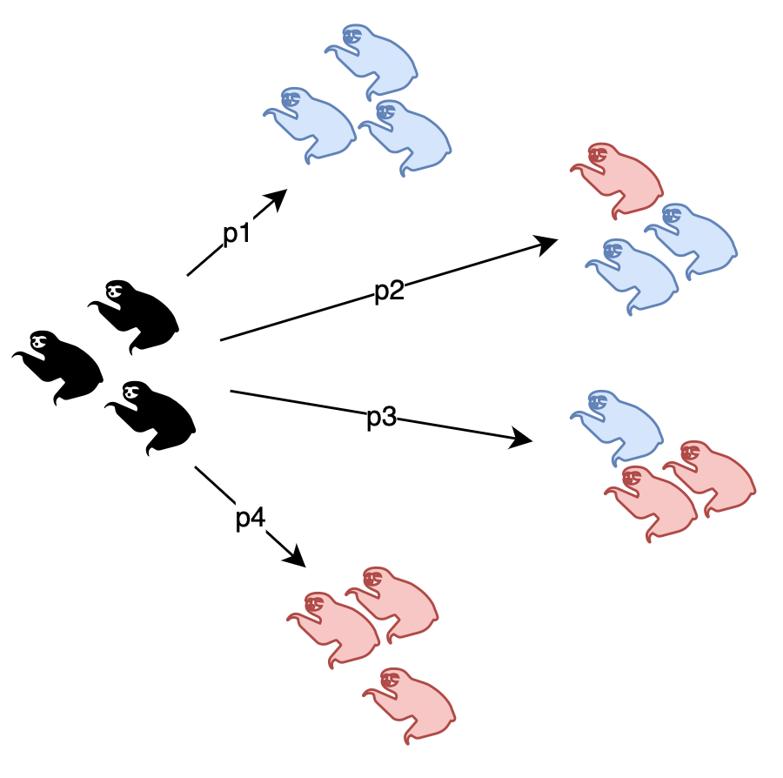
Research Questions
#3 What are the parameters of the underlying model?
→ Find the parameters of a parametric model that best describe an observed phenomenon
11/24/2021
Applications of Gaussian Processes in Modelling Biological Collectives

Slide 8
Research Questions
#1 What is the collective response?
→ Predict the behaviour of populations of different sizes
#2 What is the fitness function the collective tries to optimise?
→ Find a pattern of behavioural responses over populations of different sizes
#3 What are the parameters of the underlying model?
→ Find the parameters of a parametric model that best describe an underlying behaviour/phenomenon
11/24/2021
Applications of Gaussian Processes in Modelling Biological Collectives
Notes:
Predict Collective response
Infer Individual behaviour

Slide 9
Preliminaries
Markov Chains (MC)
Model sequence of probabilistic events
Discrete-time (DTMC) or Continuous-time (CTMC)
Parametric MC: transitions can involve uncertain parameters
Population MC: study behaviour and interactions of discrete agents
Verify using Temporal Logic
Probabilistic Computational Temporal Logic (PCTL): verify DTMCs
Continuous Stochastic Logic (CSL): verify CTMC
Chemical Reaction Networks (CRN)
Set of reactions that describe interactions of species
Deterministic analysis: ODEs
Stochastic analysis: CTMC
11/24/2021
Applications of Gaussian Processes in Modelling Biological Collectives

Slide 10
Methodology
Gaussian Processes (GP)
Non-parametric, kernel-based probabilistic approach to describe, learn and optimise unknown functions
Generalisation of multivariate Gaussian to infinite dimension
Describes distribution over functions
Result provides estimate + confidence interval
Define prior over functions, derive posterior when data is observed
Kernel function as similarity measure between data points, defines covariance matrix
f(x) ~ GP(m(x), k(x,x‘))
Rasmussen (2006)
11/24/2021
Applications of Gaussian Processes in Modelling Biological Collectives

Slide 11
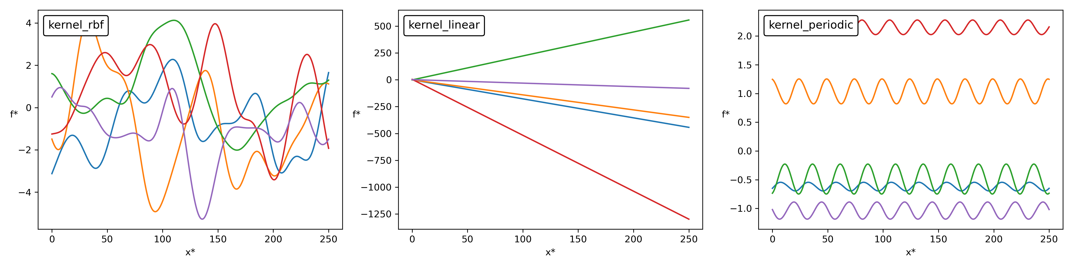
Gaussian Process
Kernels
Assumption: similar data points should have similar output values
Hyperparameters define the precise shape
Linear: $k_{lin}(x,x^{′})=σ_{b}^{2}+σ^{2}(x-c)(x^{′}-c)$
RBF: $k_{rbf}(x,x^{′})=σ^{2}exp(-\frac{||x-x^{′}||^{2}}{2ℓ^{2}})$
Periodic: $k_{per}(x,x^{′})=σ^{2}exp(-\frac{2\sin^{2}(π||x-x^{′}||/p)}{ℓ^{2}})$
11/24/2021
Applications of Gaussian Processes in Modelling Biological Collectives
Notes:
These hyperparameters are either set to a default value or optimised in the regression workflow

Slide 12
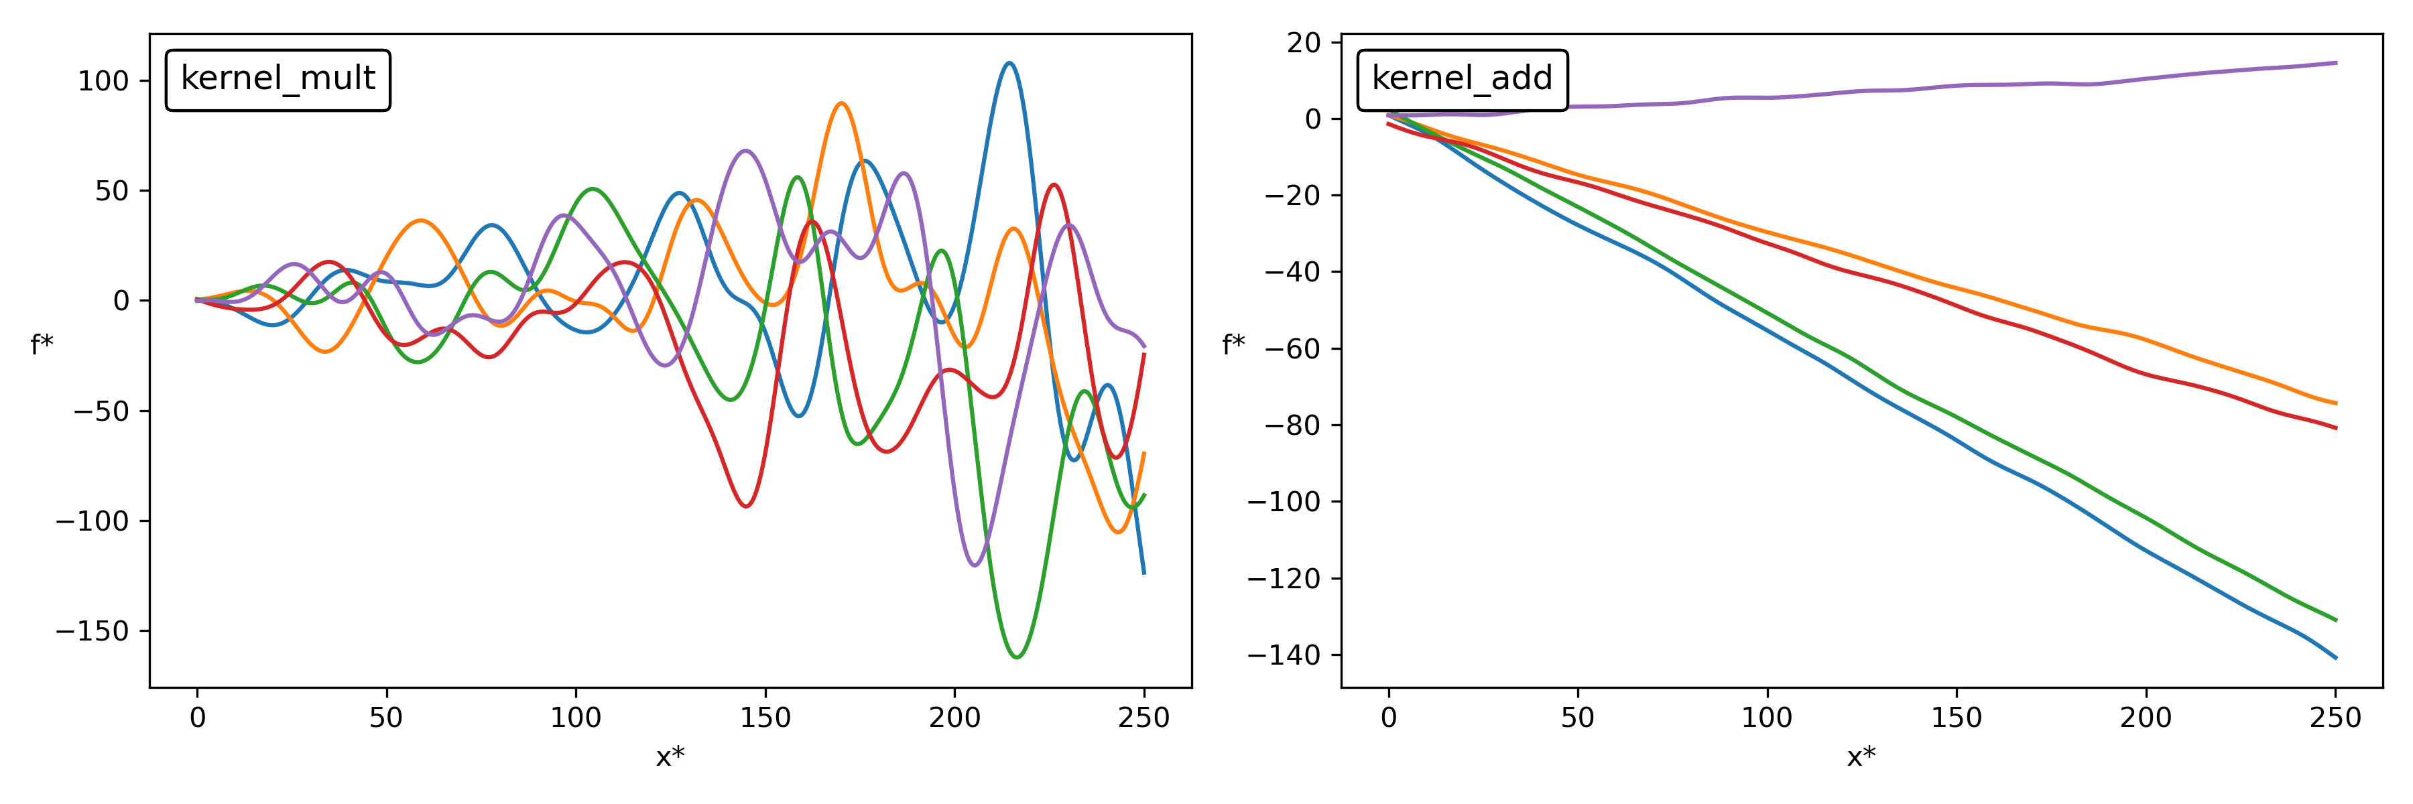
Gaussian Process
Combination of kernels
Multiplication:
Addition:
RBF-ARD kernel for multidimensional input
$$k_{1}⋅k_{2}=k_{1}(x,x^{′})⋅k_{2}(x,x^{′})$$
$$k_{1}+k_{2}=k_{1}(x,x^{′})+k_{2}(x,x^{′})$$
$$k_{rbf-ard}(x,x^{′})=∏_{d=1}^{D}σ_{d}^{2}exp(-\frac{||x_{d}-x_{d}^{′}||^{2}}{2ℓ_{d}^{2}})=σ^{2}exp(-\frac{1}{2}∑_{d=1}^{D}\frac{||x_{d}-x_{d}^{′}||^{2}}{ℓ_{d}^{2}})$$
11/24/2021
Applications of Gaussian Processes in Modelling Biological Collectives
Notes:
RBF-ARD: 2 lengthscales for both inputs to control shapes
-> automatic relevance determination: through lenghtscales

Slide 13
Gaussian Process Regression (GPR)
Workflow
Define prior as a GP
Observe training data: inputs $X$, outputs $f$
Joint distribution of training and test outputs:
Posterior distribution: condition the joint Gaussian prior on the observations
Evaluate to get predictions $f_{*}$
2x standard deviation of each test point to get 95% confidence regions
$$\left[\begin{aligned}f \\ f_{*}\end{aligned}\right]∼N\left(\begin{aligned}[\begin{aligned}μ \\ μ_{*}\end{aligned}],[\begin{matrix}Σ & Σ_{*} \\ Σ_{*}^{T} & Σ_{**}\end{matrix}]\end{aligned}\right)$$
$$f_{*}|X_{*},X,f∼N(Σ_{*}^{T}Σ^{-1}f,Σ_{**}-Σ_{*}^{T}Σ^{-1}Σ_{*})$$
11/24/2021
Applications of Gaussian Processes in Modelling Biological Collectives

Slide 14
Gaussian Process Regression (GPR)
Noisy observations
Assume we have training data $y=f(x)+ϵ$ with $ϵ∼N(0,σ_{f}^{2}I)$
Replace $Σ$ by $Σ_{y}:=Σ+σ_{f}^{2}I$ to get new posterior
Hyperparameter optimisation
Maximise marginal likelihood $p(y|X)=∫p(y|f,X)p(f|X)df$
Here: minimise negative log marginal likelihood wrt. hyperparameters
$$f_{*}|X_{*},X,y∼N(Σ_{*}^{T}Σ_{y}^{-1}y,Σ_{**}-Σ_{*}^{T}Σ_{y}^{-1}Σ_{*})$$
$$\text{log}p(y|X)=\text{log}N(y|0,Σ_{y})=-\frac{1}{2}yΣ_{y}^{-1}y-\frac{1}{2}\text{log}|Σ_{y}|-\frac{1}{2}N\text{log}(2π)$$
11/24/2021
Applications of Gaussian Processes in Modelling Biological Collectives

Slide 15
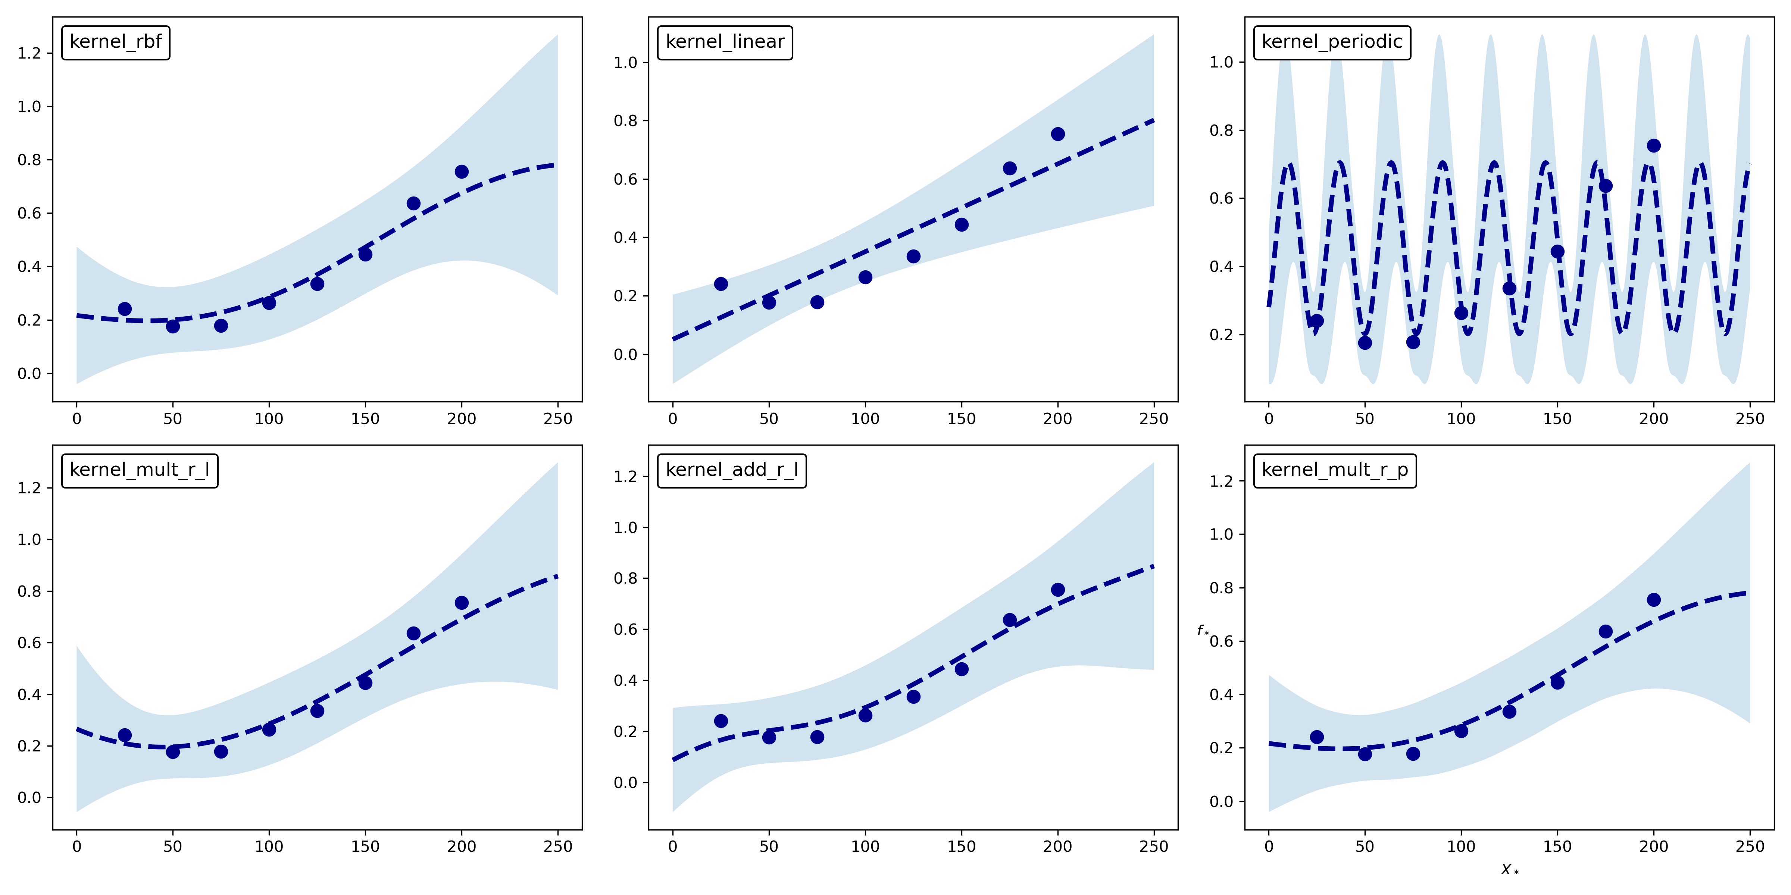
Gaussian Process Regression (GPR)
Validation
Leave-One-Out Cross-Validation: split data into K=N folds, train model on all folds but the k-th one and test on remaining folds
Summary statistics to give overall evaluation
MSE: $\frac{∑_{i}(y_{i}-f_{*_{i}})^{2}}{n}$
11/24/2021
Applications of Gaussian Processes in Modelling Biological Collectives
Notes:
MSE = 0.3554 for linear kernel

Slide 16
Gaussian Process Classification (GPC)
Overview
Predict class label $y∈[0,1]$ from Boolean observations for binary classification problem
Probability of belonging to a class at input $x$ is related to value of some latent function $f(x)$
Place GP prior over $f(x)$, then squash with inverse probit transformation to map real values to probabilities
Prior on class probabilities $π(x)≜p(y=1|x)=Φ(f(x))$
$$Φ(z)=∫_{-∞}^{z}N(x|0,1)dx=\frac{1}{2}+\frac{1}{2}⋅erf\left(\frac{x}{\sqrt{2}}\right)$$
11/24/2021
Applications of Gaussian Processes in Modelling Biological Collectives
Notes:
The main workflow of GPC is similar to GPR. After defining a GP Prior over
a suitable function space, the functional form of the likelihood is determined to
approximate the posterior distribution. Here, the goal is to get an estimate of a
class probability for unknown data points from Boolean observations
We do not observe values of f
itself, only the inputs X and class labels y, but need this function to define the GP
model
probit function is equal to
the inverse of the standard normal cumulative distribution function (CDF). To map
real numbers to probabilities, we need to compute the inverse probit transformation,
i.e. the CDF

Slide 17
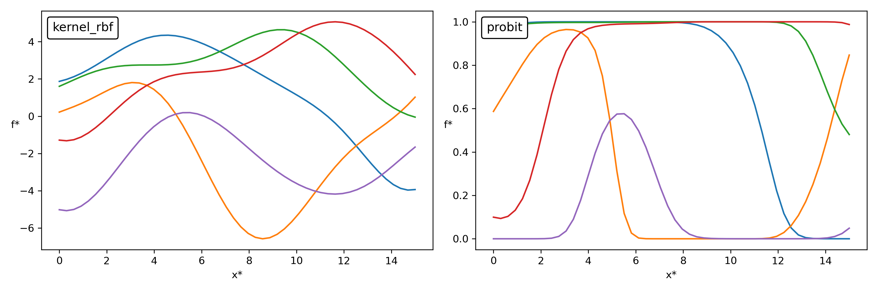
Gaussian Process Classification (GPC)
Example Prior
RBF kernel with $σ^{2}=7,ℓ=3$
11/24/2021
Applications of Gaussian Processes in Modelling Biological Collectives

Slide 18
Gaussian Process Classification (GPC)
Workflow
Compute distribution of latent variable corresponding to a test case
Predictions for a class probability:
Problem: likelihood is non-Gaussian
Approximate joint posterior by a Gaussian distribution
$$p(f_{*}|X,y,x_{*})=∫p(f_{*}|X,x_{*},f)p(f|X,y)df$$
$${\overline{π}}_{*}≜p(y_{*}=1|X,y,x_{*})=∫Φ(f_{*})p(f_{*}|X,y,x_{*})df_{*}$$
11/24/2021
Applications of Gaussian Processes in Modelling Biological Collectives

Slide 19
Gaussian Process Classification (GPC)
Expectation Propagation (EP)
Replace non-Gaussian observation likelihoods
Product of likelihoods:
Approximate posterior:
$$p(y_{i}|f_{i})≃t_{i}(f_{i}|{\overset{˜}{Z}}_{i},{\overset{˜}{μ}}_{i},{\overset{˜}{σ}}_{i}^{2})≜{\overset{˜}{Z}}_{i}N(f_{i}|{\overset{˜}{μ}}_{i},{\overset{˜}{σ}}_{i}^{2})$$
$$\overset{n}{\underset{i=1}{∏}}t_{i}(f_{i}|{\overset{˜}{Z}}_{i},{\overset{˜}{μ}}_{i},{\overset{˜}{σ}}_{i}^{2})=N(μ,\overset{˜}{Σ})\underset{i}{∏}{\overset{˜}{Z}}_{i}$$
$$q(f|X,y)\overset{Δ}{=}\frac{1}{Z_{EP}}p(f|X)∏t_{i}(f_{i}|{\overset{˜}{Z}}_{i},{\overset{˜}{μ}}_{i},{\overset{˜}{σ}}_{i}^{2})=N(μ,Σ)$$
11/24/2021
Applications of Gaussian Processes in Modelling Biological Collectives
Notes:
Analytic approximation to probability distribution

Slide 20
Gaussian Process Classification (GPC)
Expectation Propagation (EP)
Choose parameters of local approximating distributions $t_{i}$ by iterating 4 steps to update individual $t_{i}$
Start from current approximate posterior, leave out one site index $i$ (remove approximate likelihood term) → cavity distribution $q_{-i}(f_{i})\overset{Δ}{=}N(f_{i}|μ_{-i},σ_{-i}^{2})$
Combine with exact likelihood for $i$ → tilted distribution
Find Gaussian approximation with moment matching → posterior marginal moments
Update EP approximation by replacing the approximation likelihood with the new $t_{i}$
11/24/2021
Applications of Gaussian Processes in Modelling Biological Collectives

Slide 21
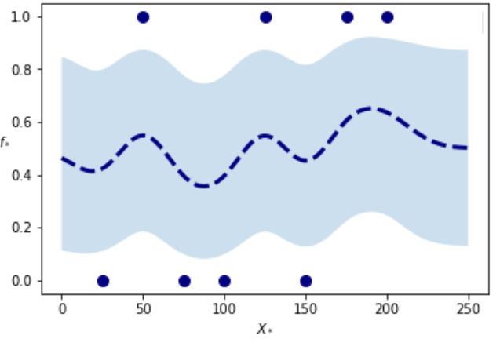
Gaussian Process Classification (GPC)
Predictions
Compute predictive mean $E_{q}[f_{*}|X,y,x_{*}]$ and predictive variance $V_{q}[f_{*}|X,y,x_{*}]$ from results of EP
Predictive probability:
Validation with MSE
$$q(y_{*}=1|X,y,x_{*})=ϕ\left(\frac{E_{q}[f_{*}|X,y,x_{*}]}{\sqrt{1+V_{q}[f_{*}|X,y,x_{*}]}}\right)$$
11/24/2021
Applications of Gaussian Processes in Modelling Biological Collectives
Notes:
MSE = 0.2580

Slide 22
Probabilistic Model Checking
Overview
Powerful in automatic formal verification of stochastic systems
Algorithmic analysis if system satisfies property
For model $M$ and property $φ$, return $P(M⊧φ)$
Result Boolean (true/false) or numerical (probability)
Analytical methods
Compute path probability of set of trajectories that satisfy $φ$
Complex, computationally expensive
Statistical methods
Simulate model, repeatedly draw trajectories, estimate satisfaction as average
Difficult to maintain accuracy
State space explosion problem
11/24/2021
Applications of Gaussian Processes in Modelling Biological Collectives

Slide 23
Smoothed Model Checking (SMMC)
Overview
Models of biological systems are often not fully specified → analyse parametric models
Find statistical estimate of satisfaction probability of $φ$ as a function of uncertain parameters $θ$
Input: few observations of trajectories (not) satisfying $φ$
GPC to obtain approximation of satisfaction function
Output: prediction of satisfaction probability for all possible values of $θ$ together with uncertainty
Here: find estimate of satisfaction function $f_{φ}(θ)=P(M_{θ}⊧φ)$ for uncertain CTMC and property in Metric Interval Temporal Logic (MITL)
Bortolussi (2016)
11/24/2021
Applications of Gaussian Processes in Modelling Biological Collectives

Slide 24
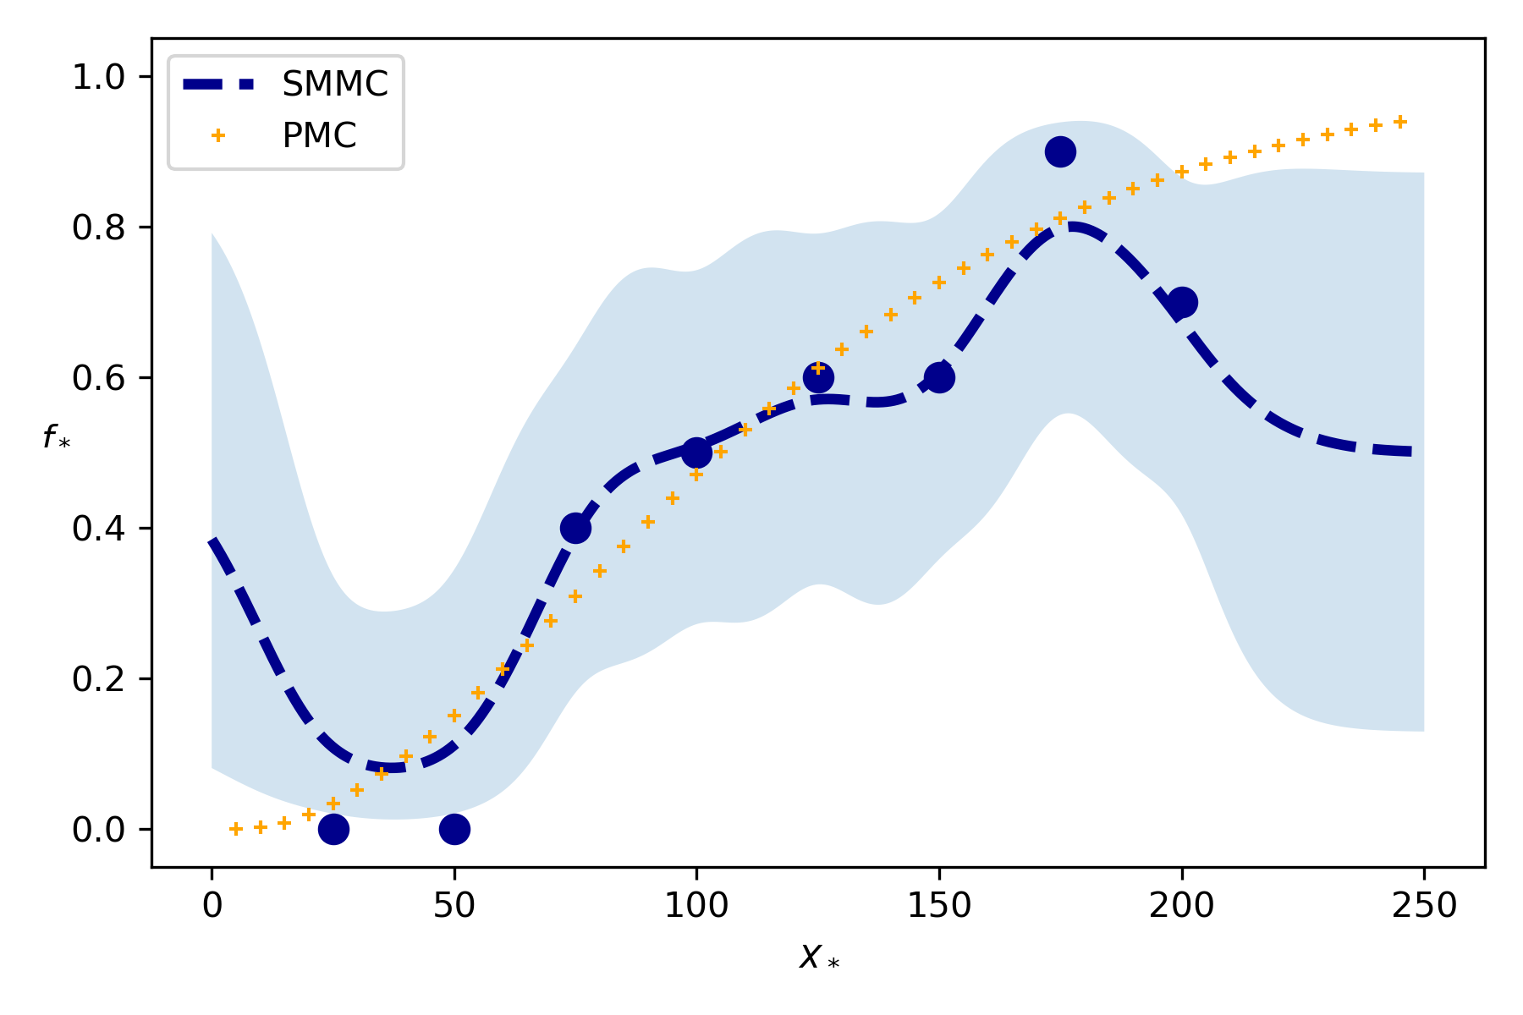
Smoothed Model Checking (SMMC)
Difference to standard GPC
Improve accuracy with multiple observations per input point
Binomial$(m,f_{φ}(θ))$ for $m$ trajectories
Intermediate estimations would increase uncertainty
Direct use of exact statistical model
Matching moments of posterior (EP step 3) include exact likelihoods → use exact observations
Predictive posterior and uncertainties are computed as before
11/24/2021
Applications of Gaussian Processes in Modelling Biological Collectives

Slide 25
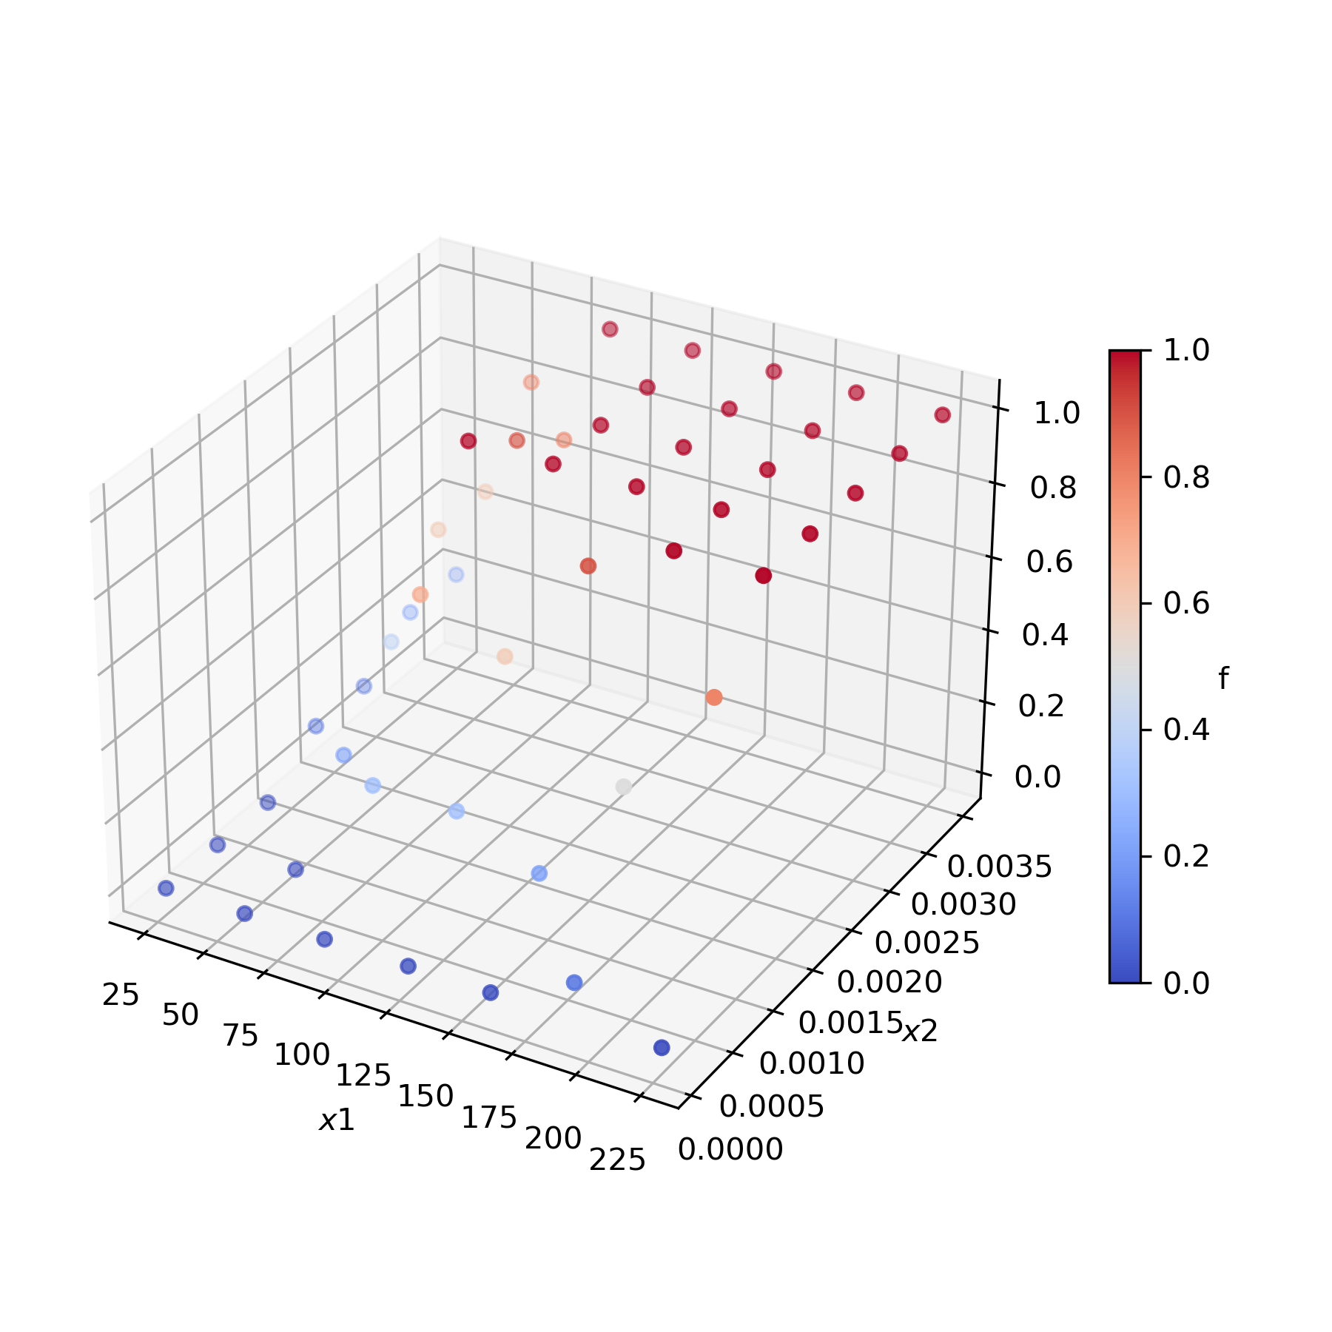
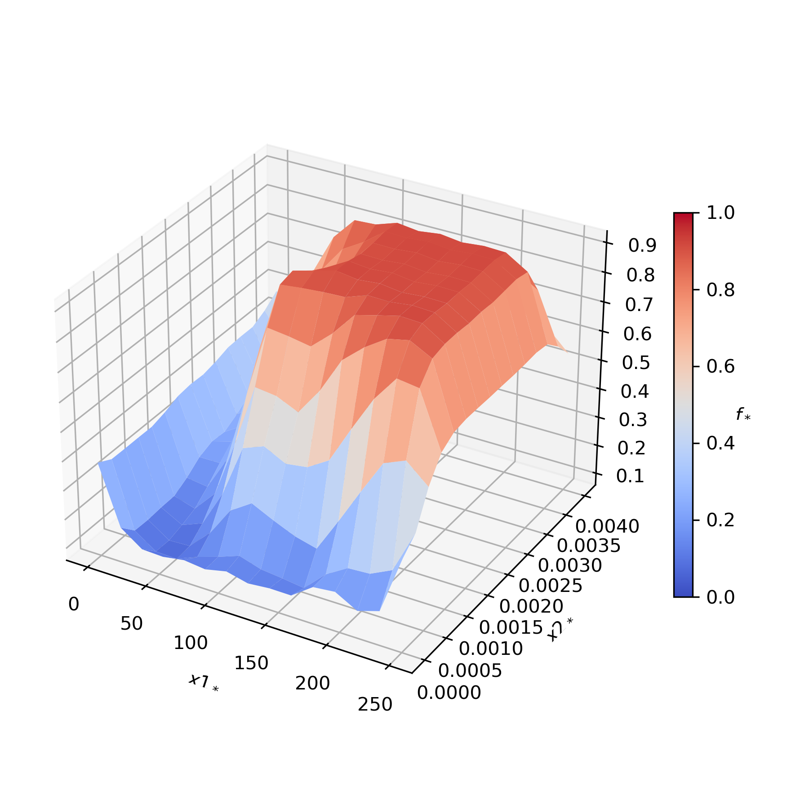
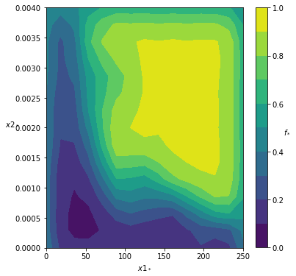
Smoothed Model Checking (SMMC)
Two-dimensional SMMC
For two uncertain parameters
RBF-ARD kernel
11/24/2021
Applications of Gaussian Processes in Modelling Biological Collectives

Slide 26
Framework
#1 Prediction of Collective Response
Often only final, discrete states of collective observable
Map to steady-state of Markov Chain
Data: count occurrences of final states → histogram
What is the collective response of populations of different sizes?
New experiments
Re-engineer and re-run stochastic model
Both expensive!
Use GPR to predict mean and variance of histograms
11/24/2021
Applications of Gaussian Processes in Modelling Biological Collectives

Slide 27
Framework
#2 Inference of Fitness Function
Is there a pattern in the response over populations of different sizes which explains the observed behaviour?
Formulate fitness function as property of biological system with unknown parameter $t$
Use SMMC for some fixed values of $t$ and varying population size $N$ to get satisfaction functions
Compare posterior distributions to find most plausible fitness function
Select distribution with high probabilities (mean) and low variation (standard deviation)
Compute coefficient of variation $c_{v}=\frac{σ}{μ}$
$c_{v}<0.1$ is considered low
Pimentel Gomes (2000)
11/24/2021
Applications of Gaussian Processes in Modelling Biological Collectives

Slide 28
Framework
#3 Parameter Inference
Infer parameters of parametric model wrt. pre-defined fitness function
To explain individual behaviour
To maximise satisfaction probability for a property
Two-dimensional SMMC
One parameter $θ$ and varying population size $N$
Two parameters $θ$
Model design
11/24/2021
Applications of Gaussian Processes in Modelling Biological Collectives

Slide 29
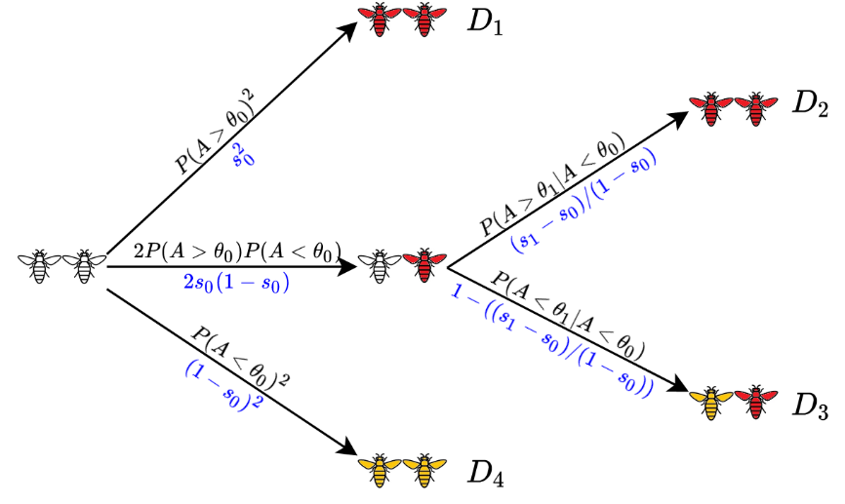
Case Study
Case Study: Social feedback in population of honeybees
Colony of bees is exposed to a threat: each bee may become aggressive, sting and die, or do nothing
Alarm pheromone P is released during stinging and increases aggressiveness of other bees
What is the mechanism that prevents the colony from becoming extinct? How is the individual bee influenced by the other bees?
Show analyses on three experimental contexts
Hajnal (2019)
11/24/2021
Applications of Gaussian Processes in Modelling Biological Collectives
Notes:
But: aggressiveness doesn‘t increase endlessly, because then all bees would eventually die

Slide 30
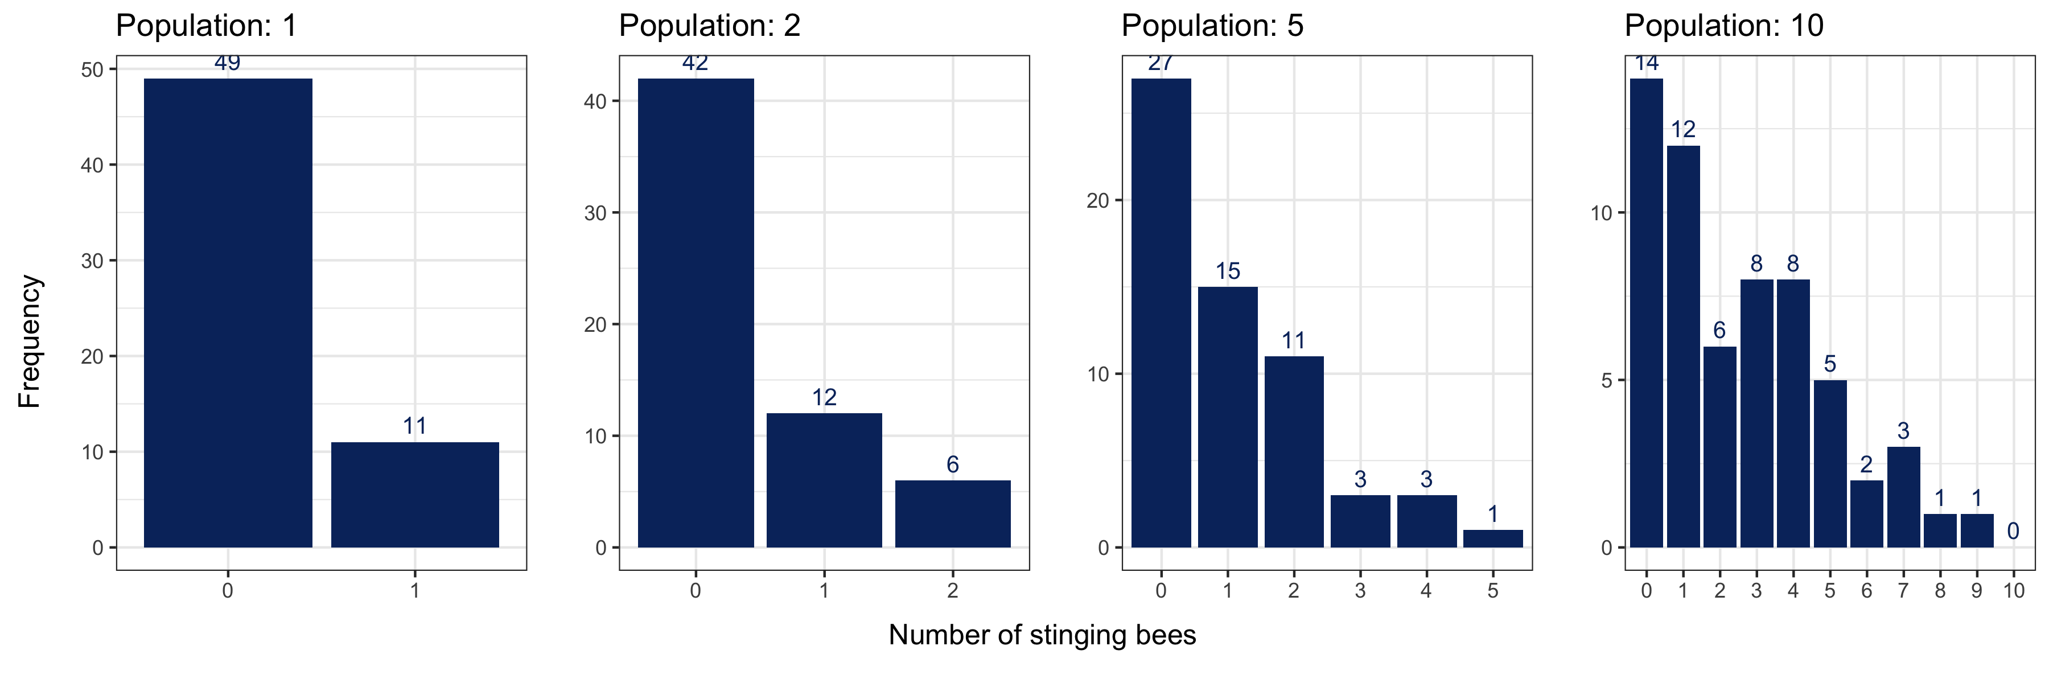
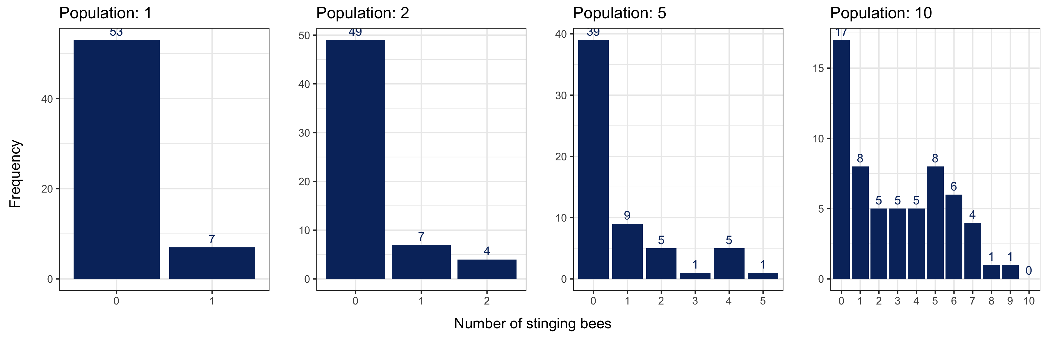
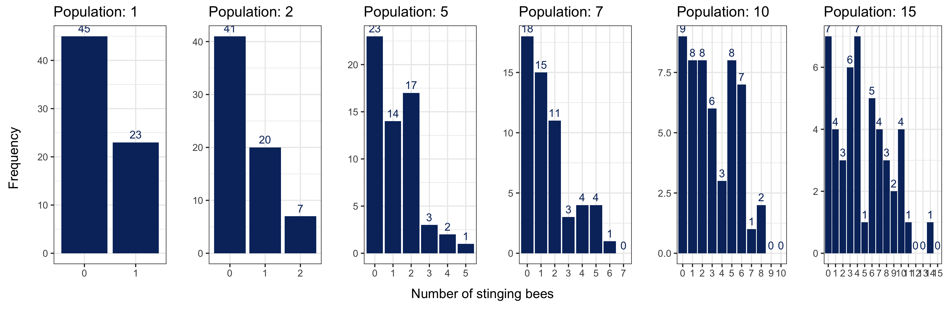
Case Study
A
1) Experimental Data
Three experiments A, B, C
Bees put into arena with threat
Outcome: number of stinging bees after each trial
B
C
11/24/2021
Applications of Gaussian Processes in Modelling Biological Collectives

Slide 31
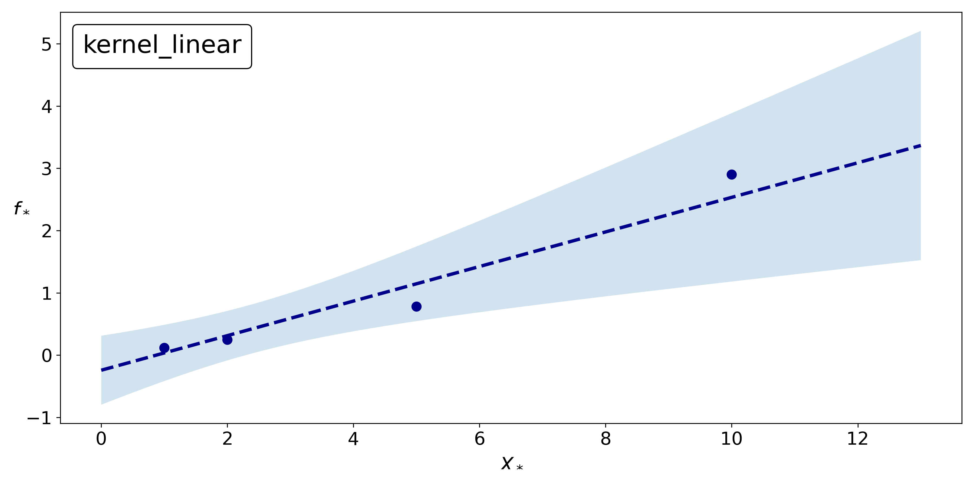
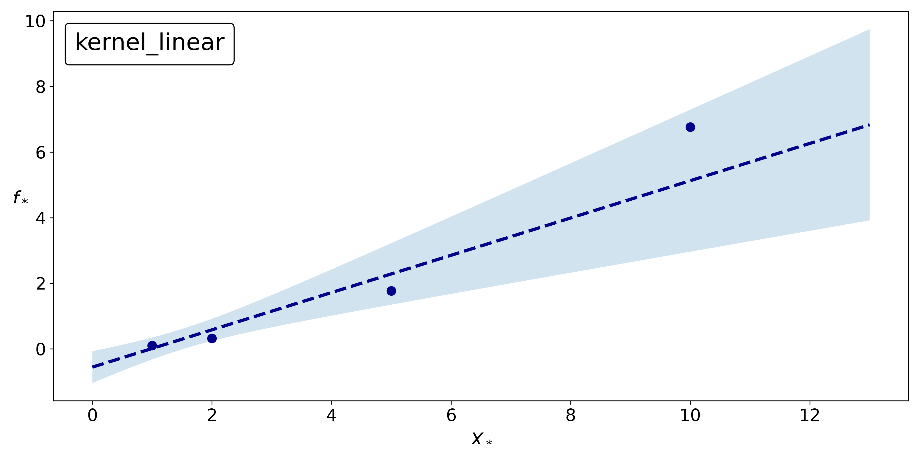
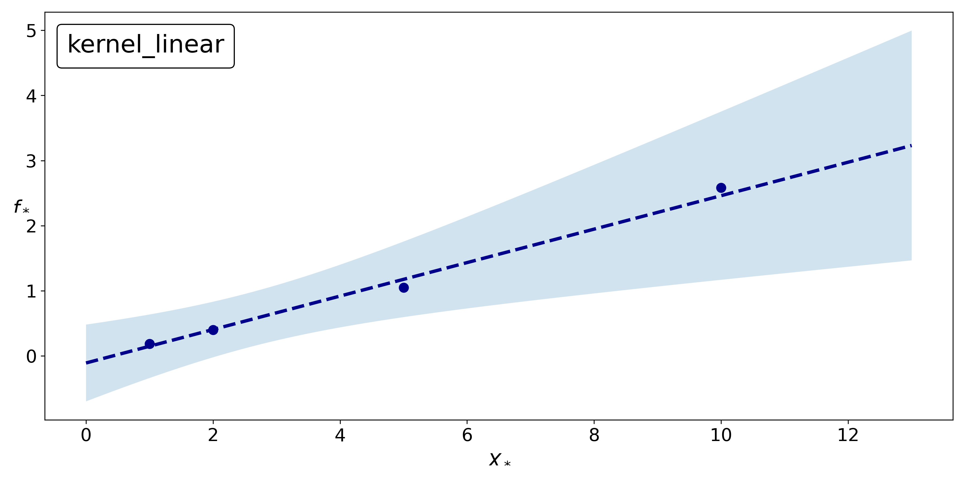
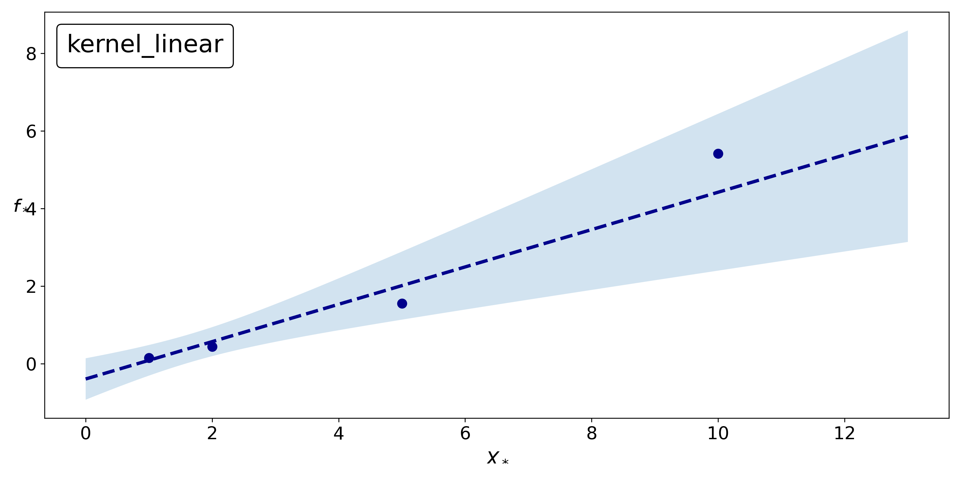
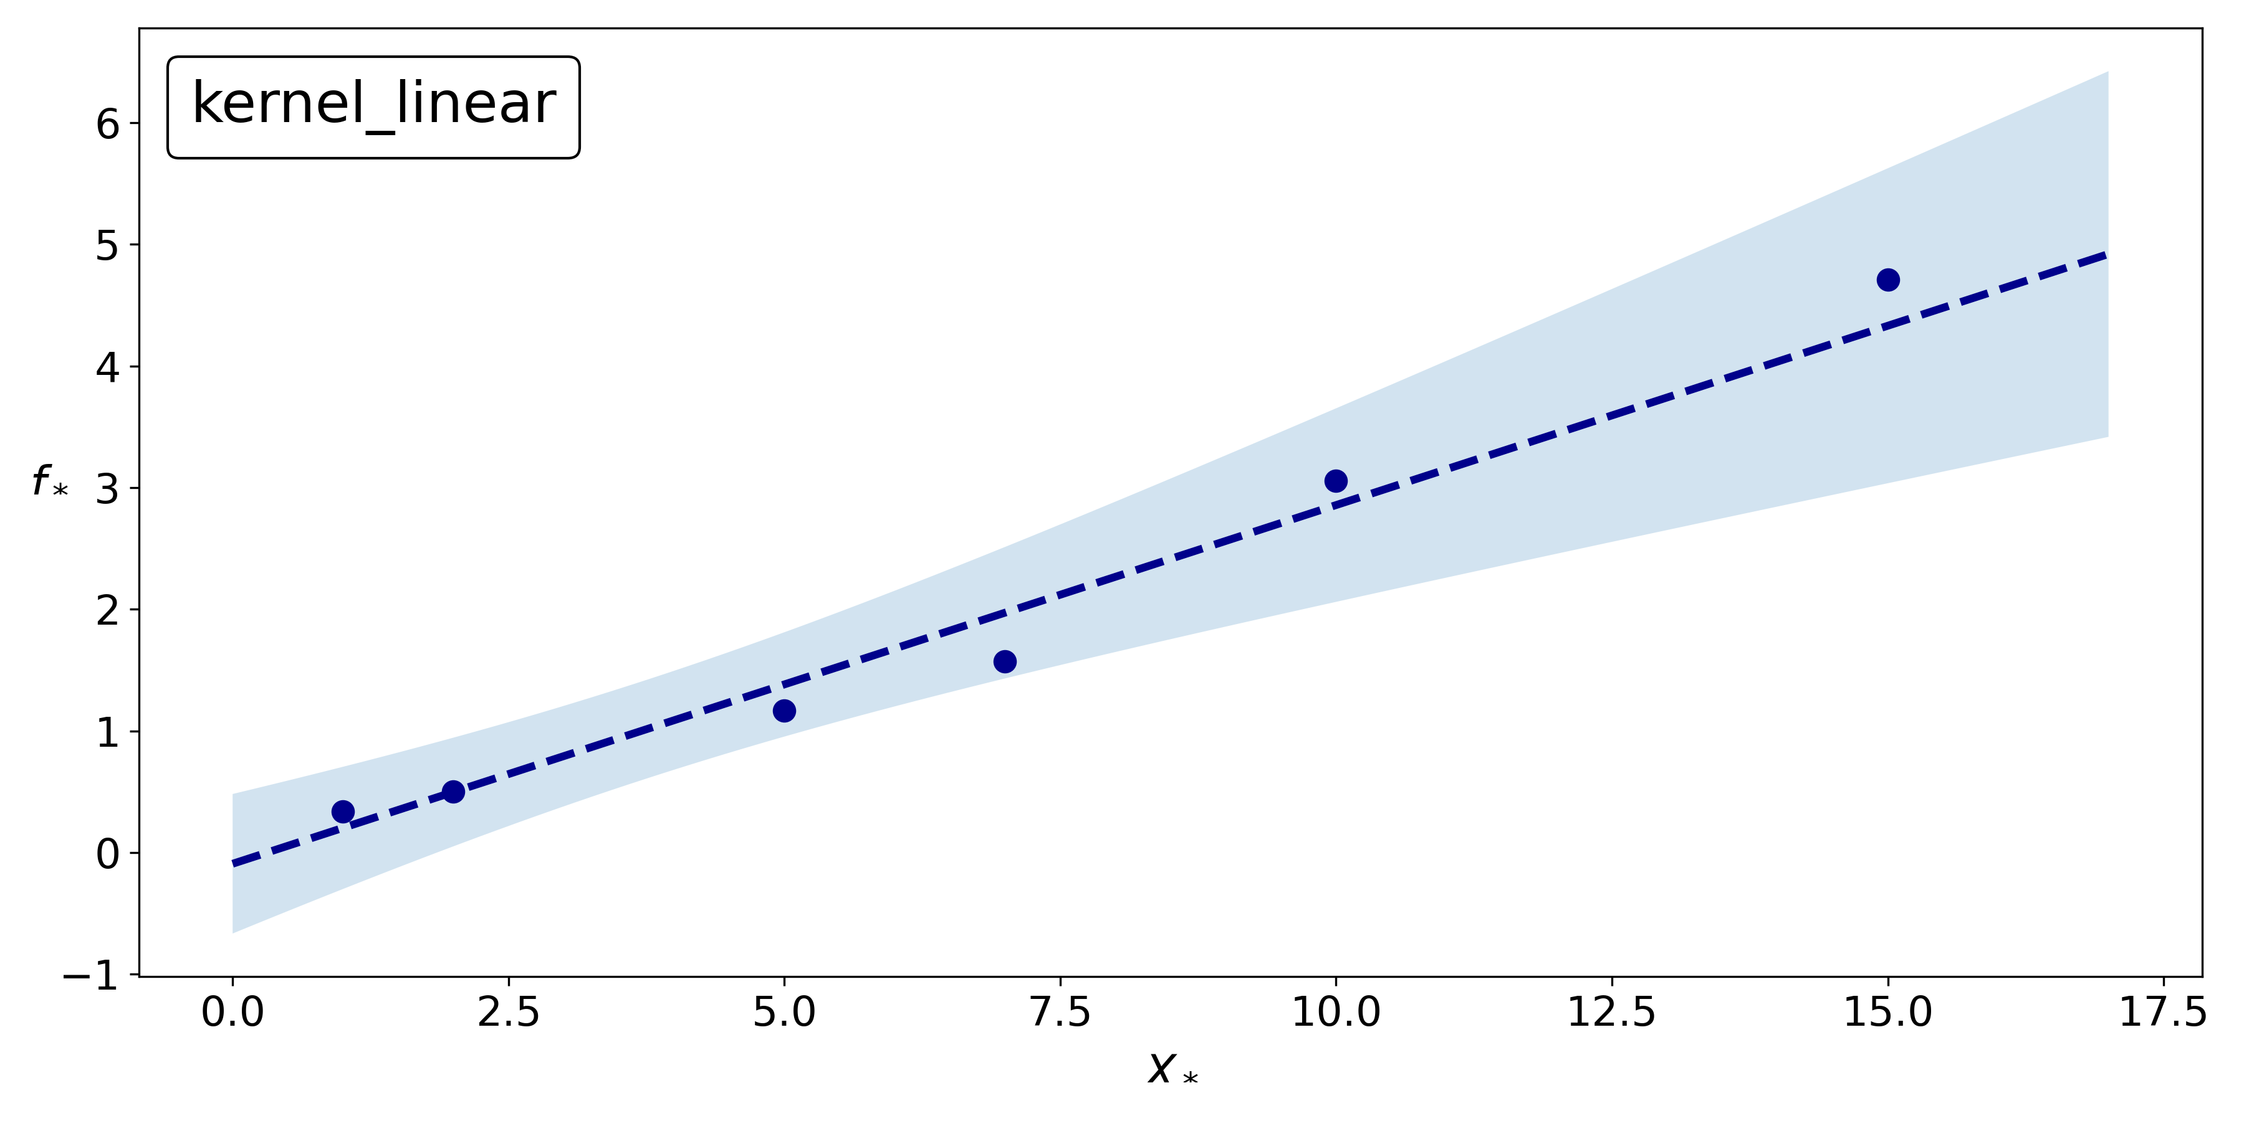
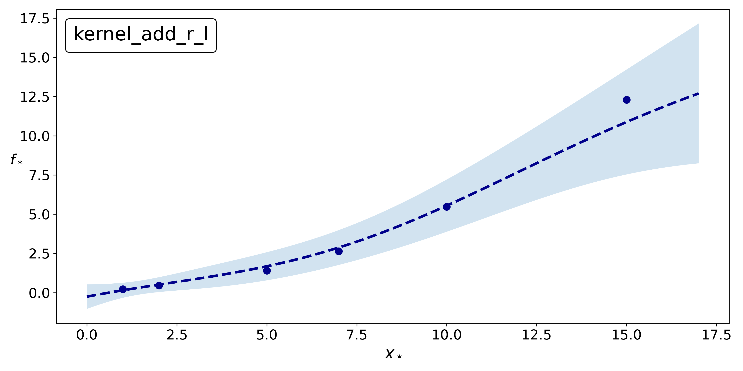
Case Study
1) Experimental Data
Predict collective response with GPR
Response: number of stinging bees (mean and variance)
Select kernel with smallest MSE according to LOOCV
Predictions for population size $N=7$:
$μ_{A}[7]=1.6897±0.8753$, $σ_{A}^{2}[7]=3.3985±1.4113$
$μ_{B}[7]=1.6791±0.8362,$ $σ_{B}^{2}[7]=2.9536±1.3157$
$μ_{C}[7]=1.9841±0.5433,$ $σ_{C}^{2}[7]=2.9034±1.1156$
Mean
Variance
A
B
C
11/24/2021
Applications of Gaussian Processes in Modelling Biological Collectives

Slide 32
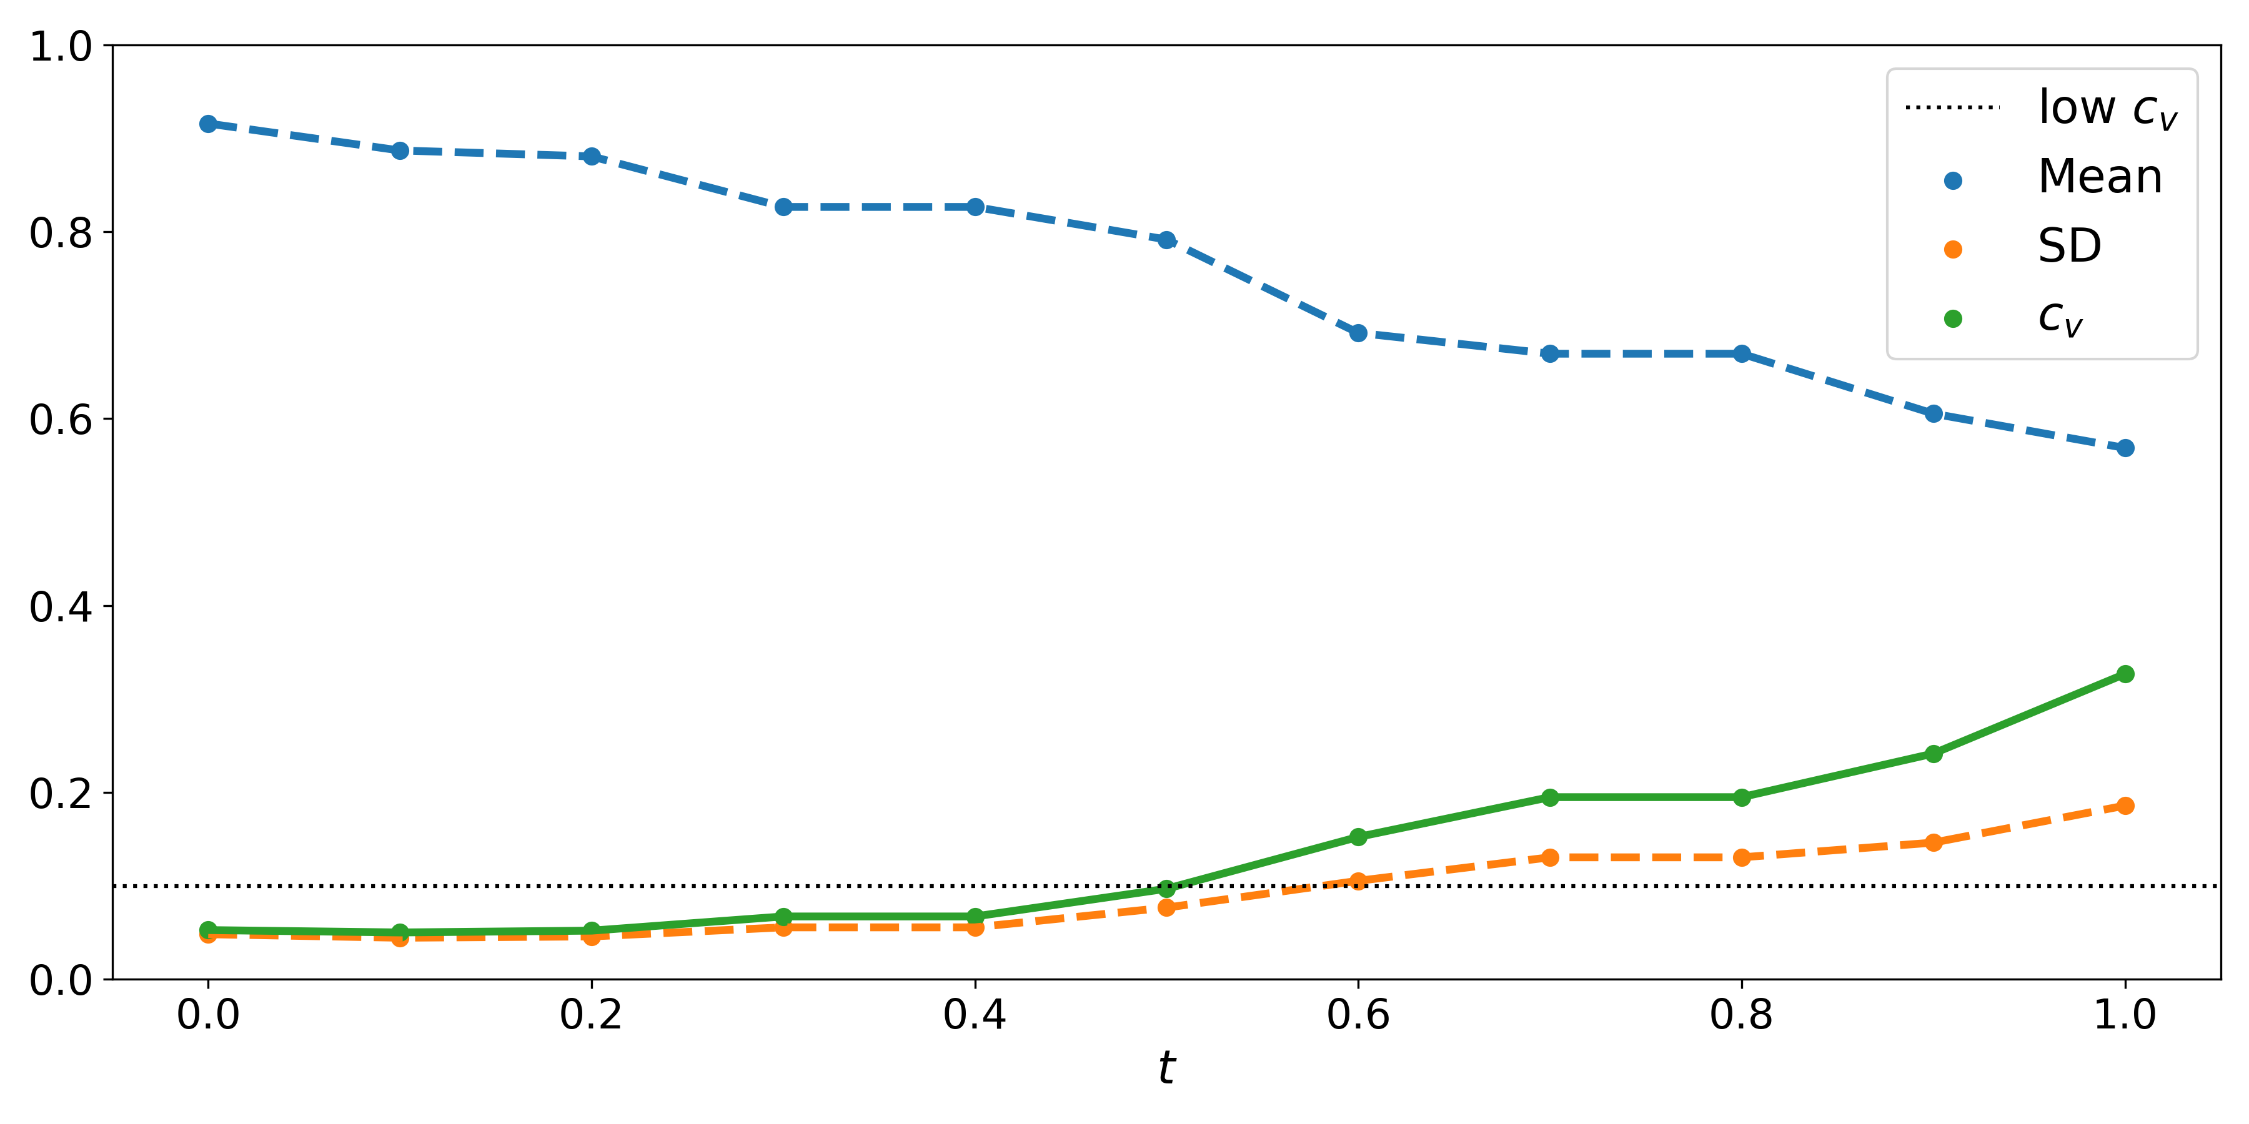
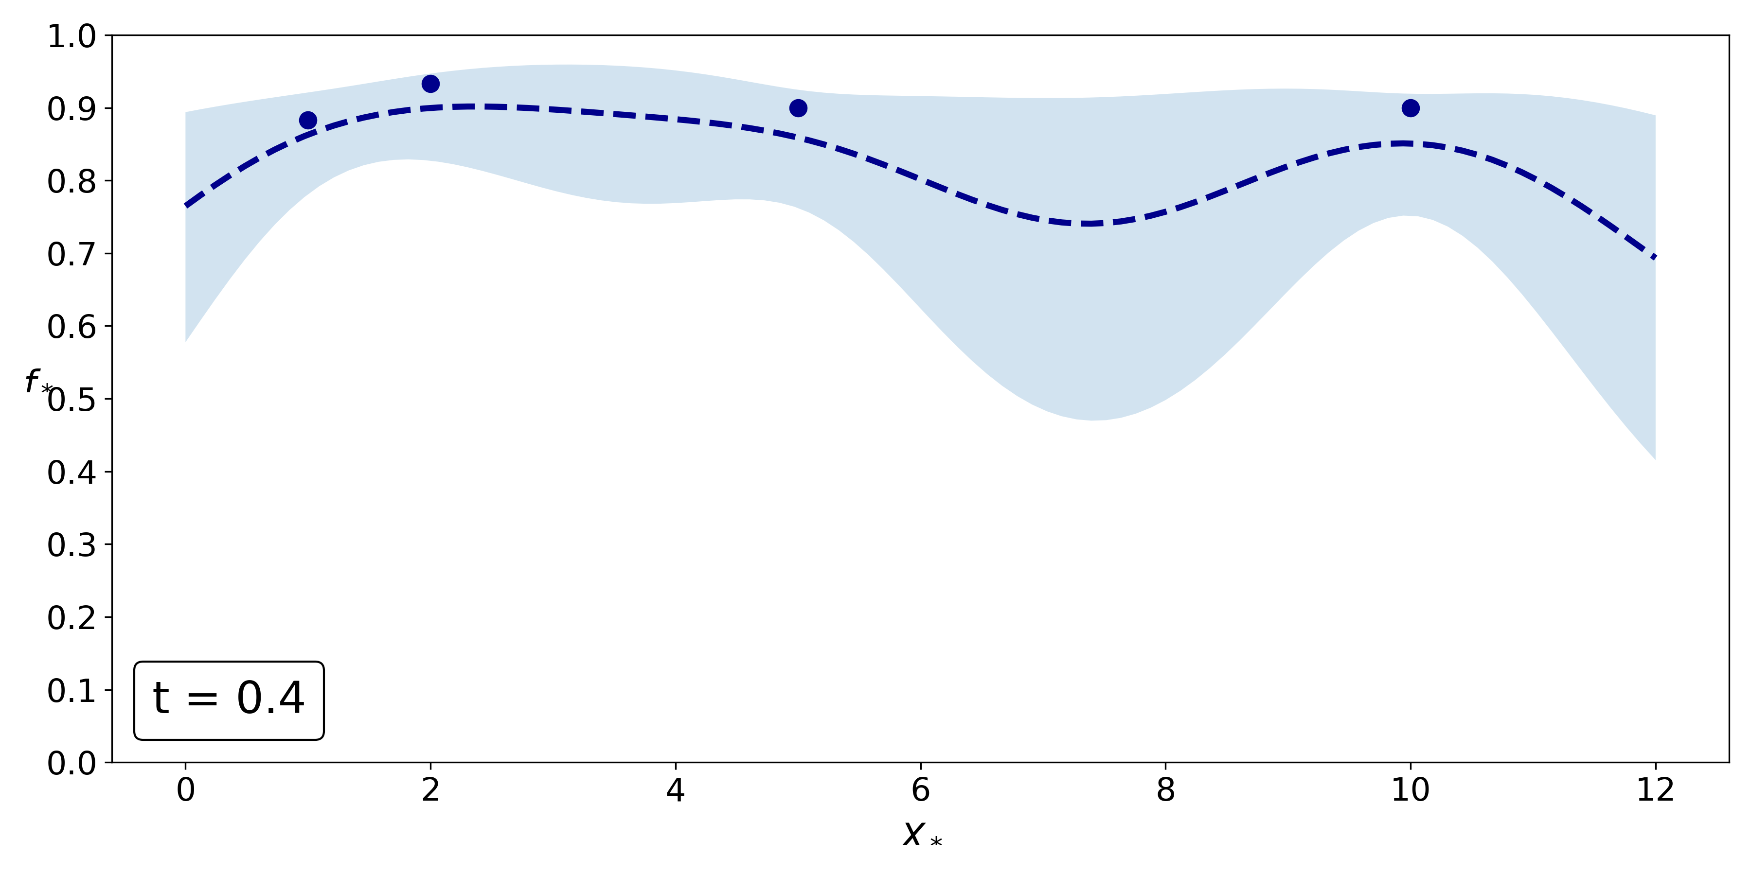
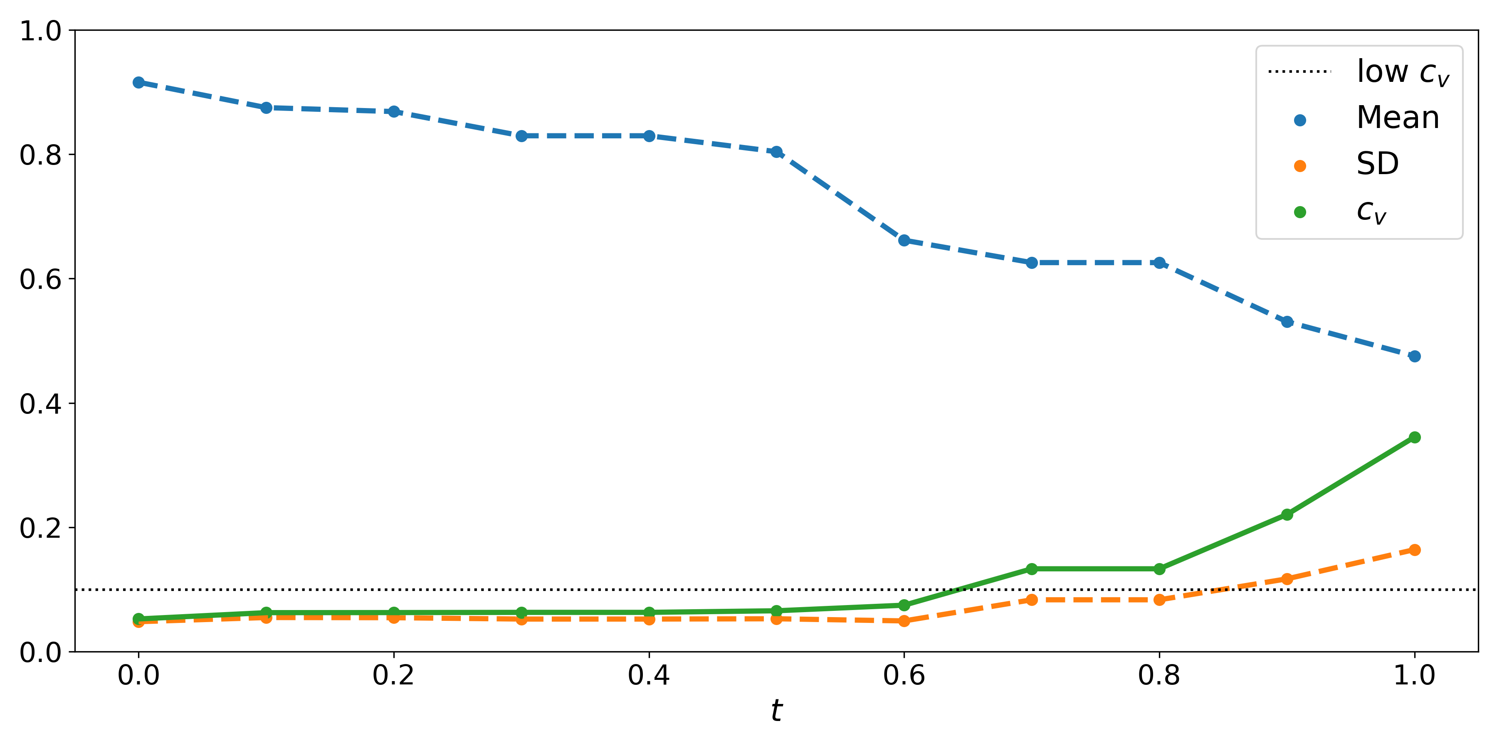
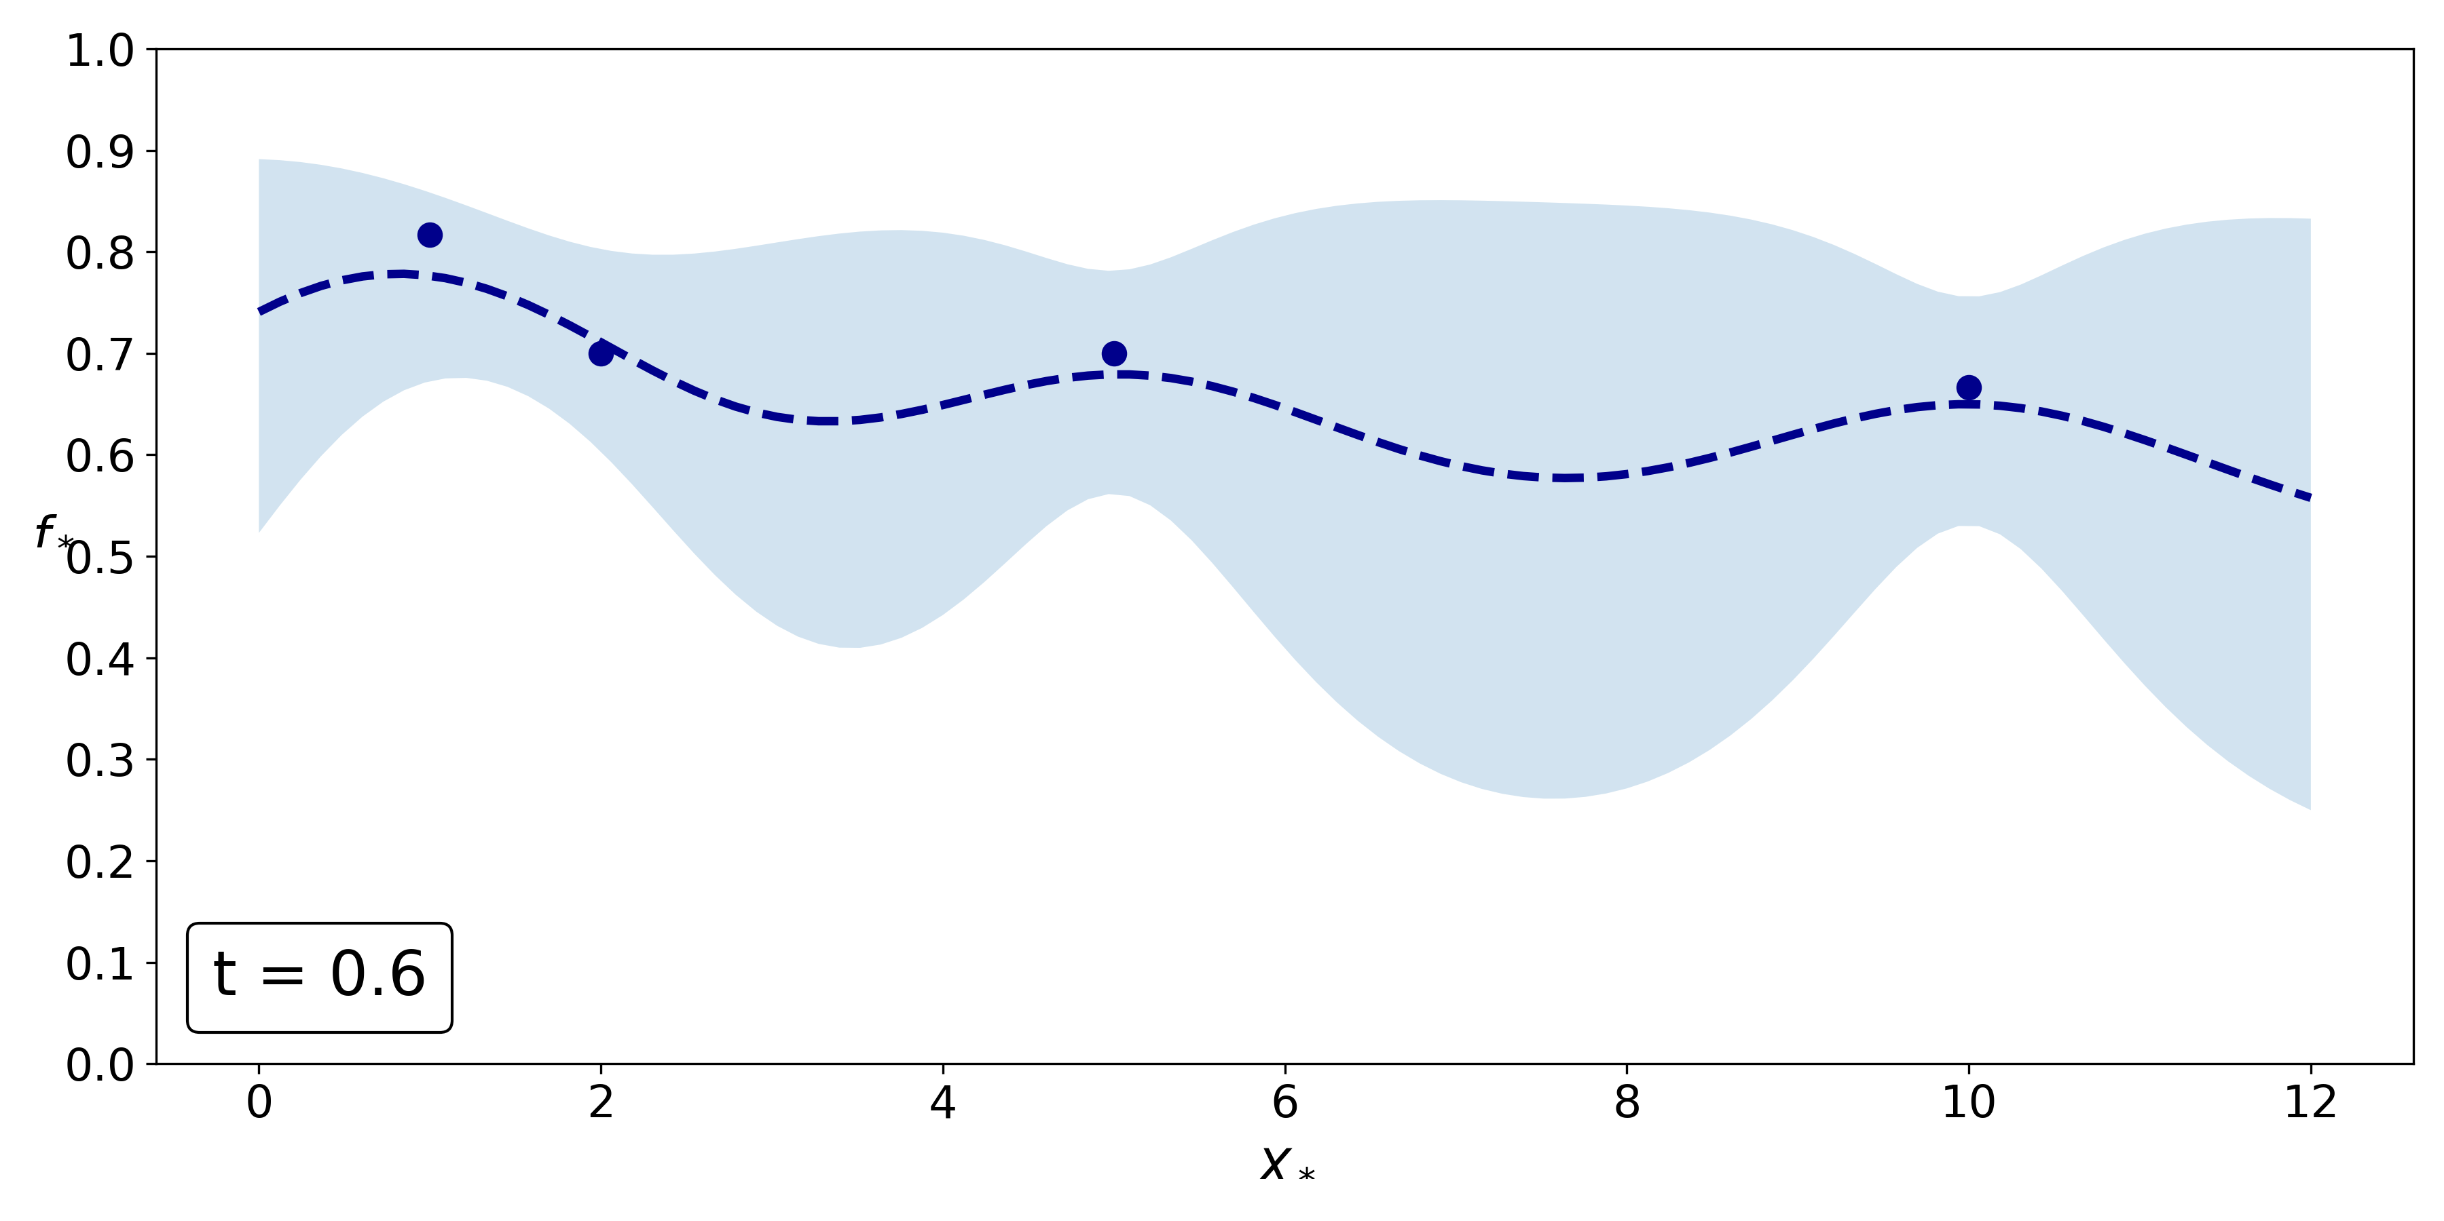
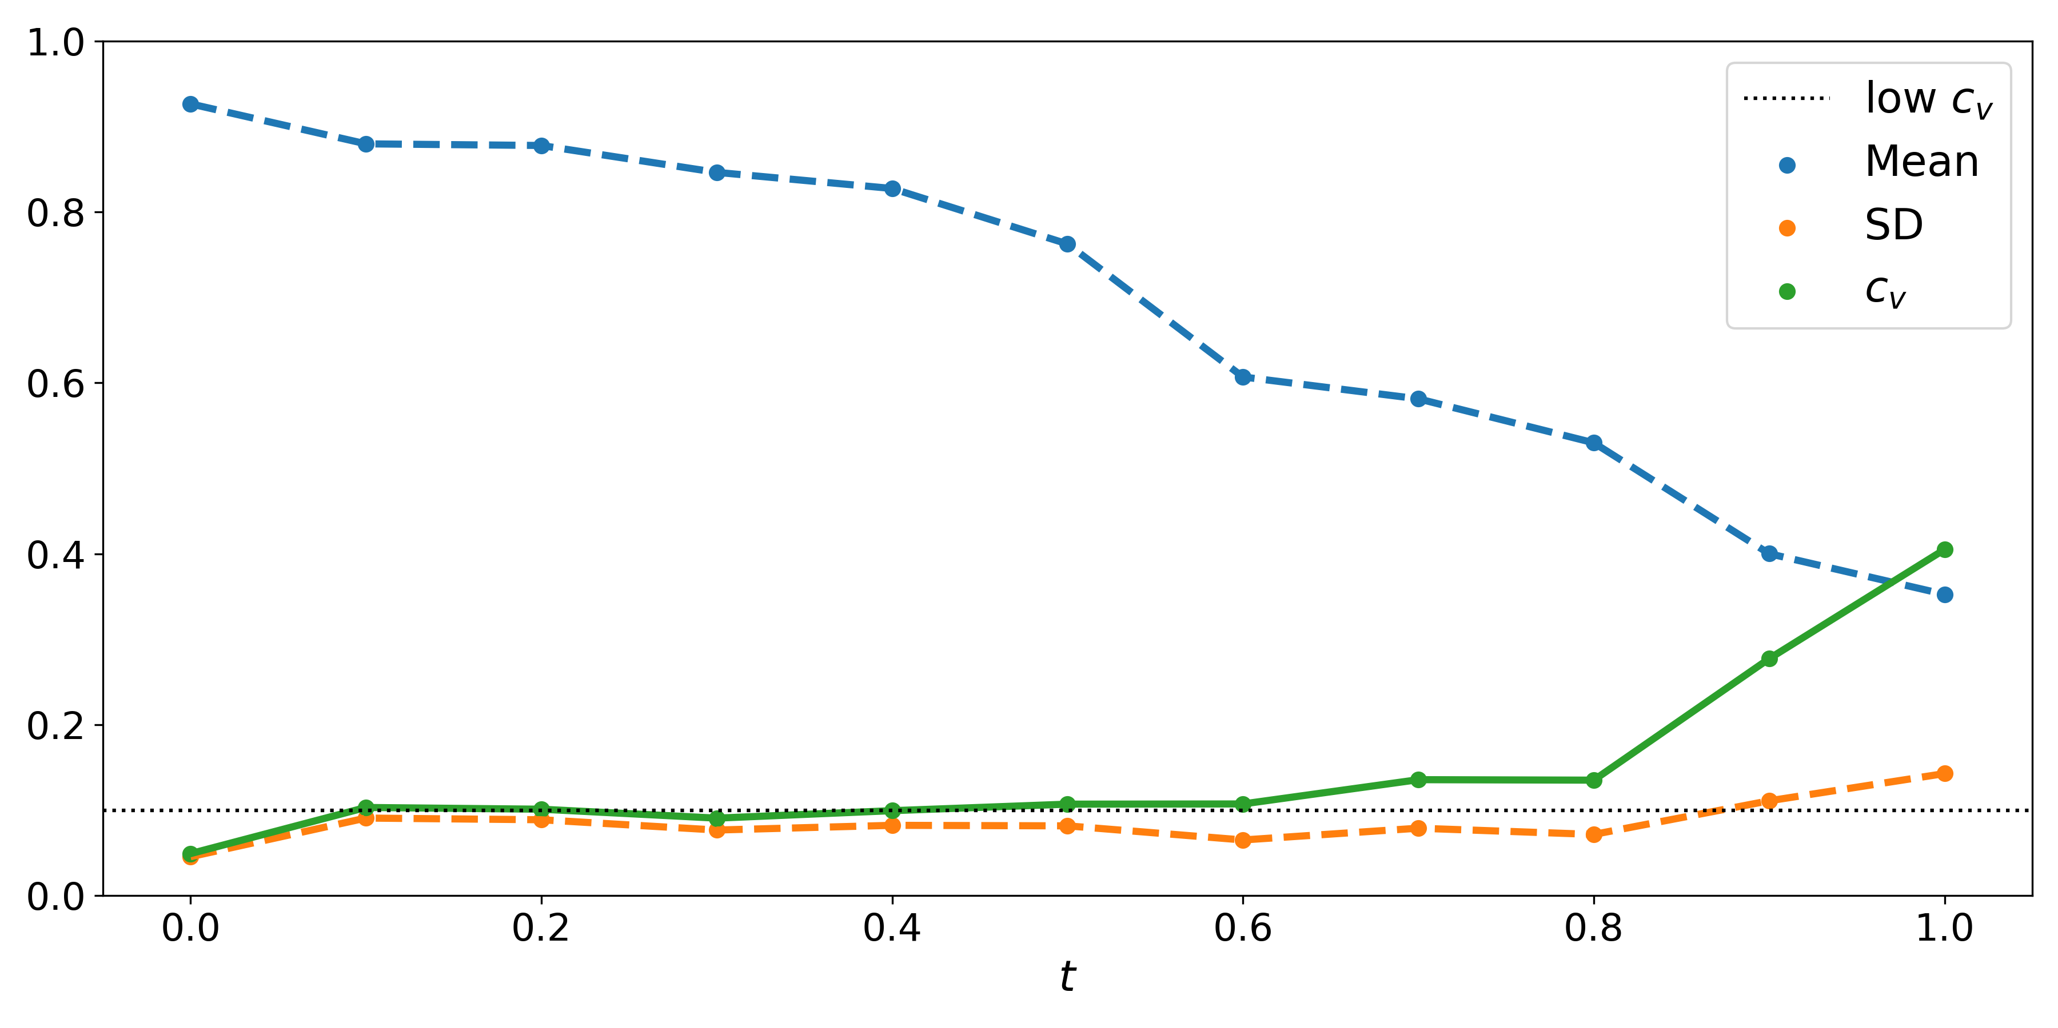
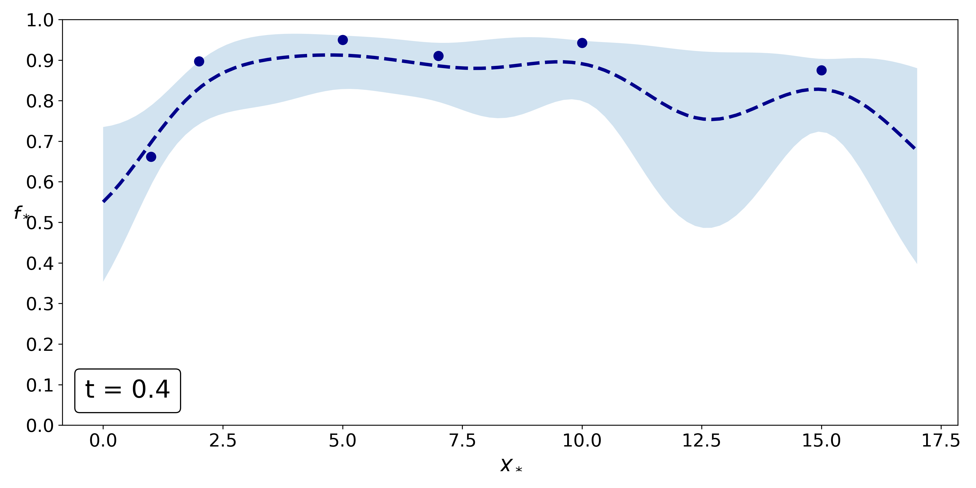
Case Study
1) Experimental Data
Infer fitness function with SMMC
Is there always a certain proportion of the population defending the whole collective?
$φ$: at least (100 $⋅$ t)% of the colony survives
Analyse satisfaction for different $t∈[0,1]$ over varying population sizes
Find largest $t$ with $c_{v}<0.1$ to get plausible fitness function
Experiment A: at least 40% survives
Experiment B: at least 60% survives
Experiment C: at least 40% survives
Mean
Variance
A
B
C
11/24/2021
Applications of Gaussian Processes in Modelling Biological Collectives

Slide 33
Case Study
2) Two-Reaction CRN
Implemented and simulated using StochNetV2
3 species: Bee, dead Bee, Pheromone
2 reactions:
Stinging: $Bee+P\overset{k_{1}}{→}BeeD+2P$
Pheromone degradation: $P\overset{k_{2}}{→}Ø$
Repin (2020)
11/24/2021
Applications of Gaussian Processes in Modelling Biological Collectives

Slide 34
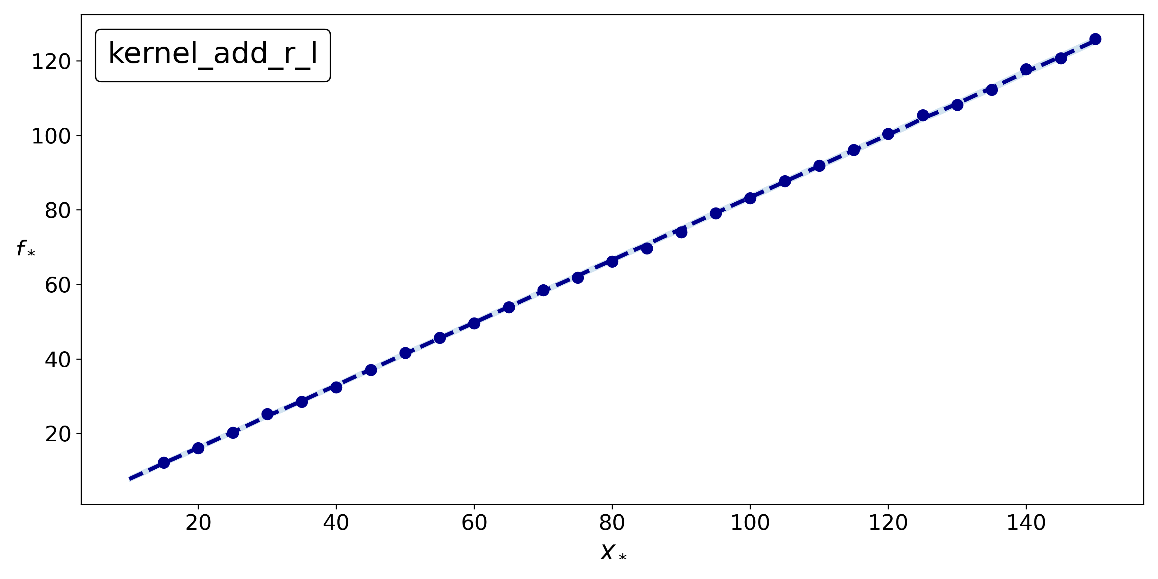
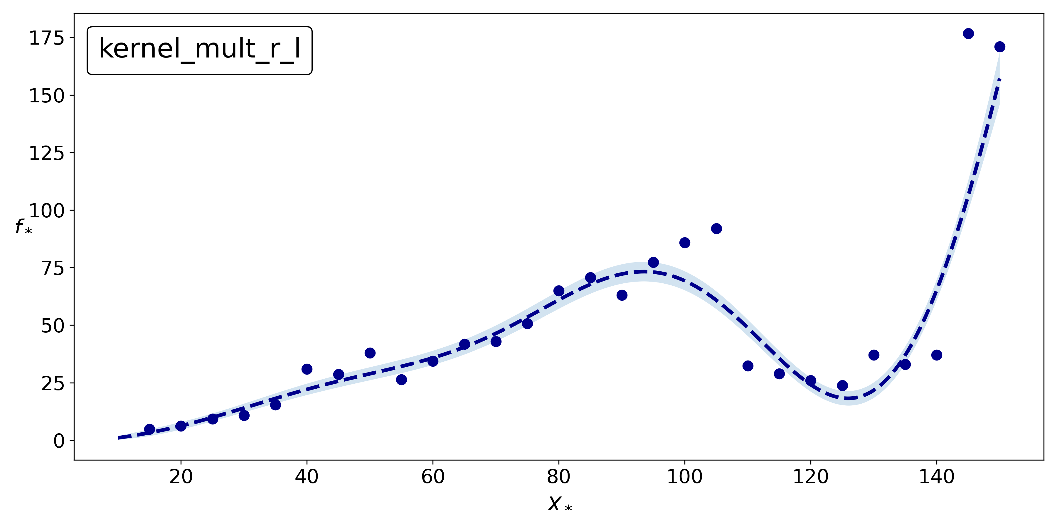
Case Study
2) Two-Reaction CRN
Predict collective response with GPR
Stinging rate $k_{1}=1/N$ and constant pheromone degradation rate $k_{2}=1$
Run CRN 1000 times for 28 population sizes $N∈[15,150]$ with $Bee(0)=P(0)=N$
Response: number of stinging bees (mean and variance)
Select kernel with smallest MSE according to LOOCV
Linear trend for mean, unexpected drop for variance
Mean
Variance
11/24/2021
Applications of Gaussian Processes in Modelling Biological Collectives

Slide 35
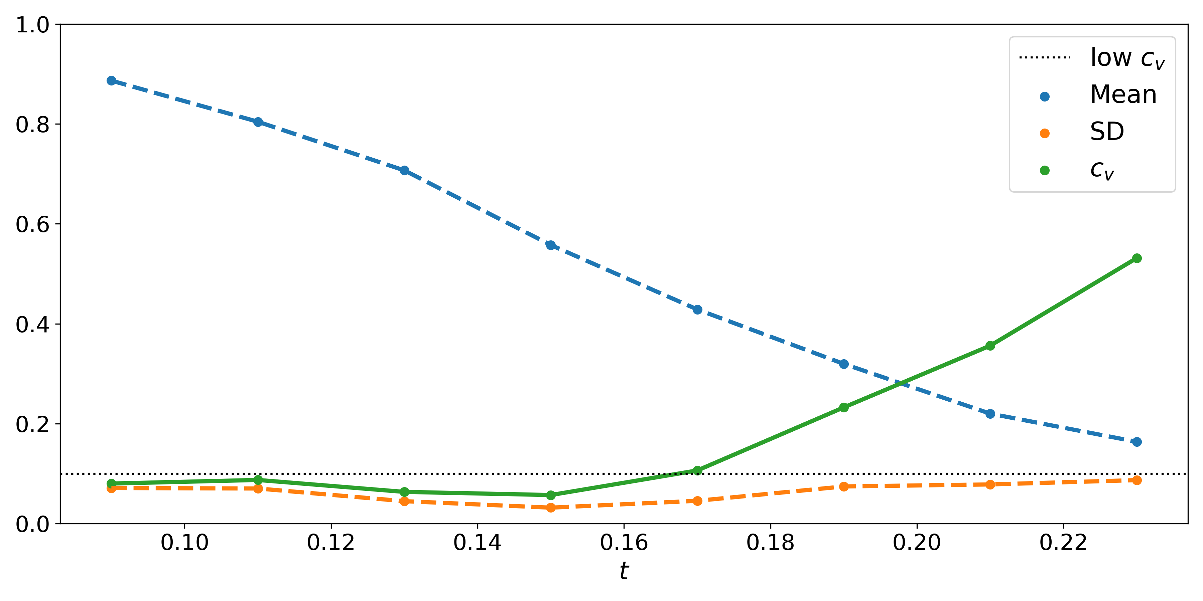
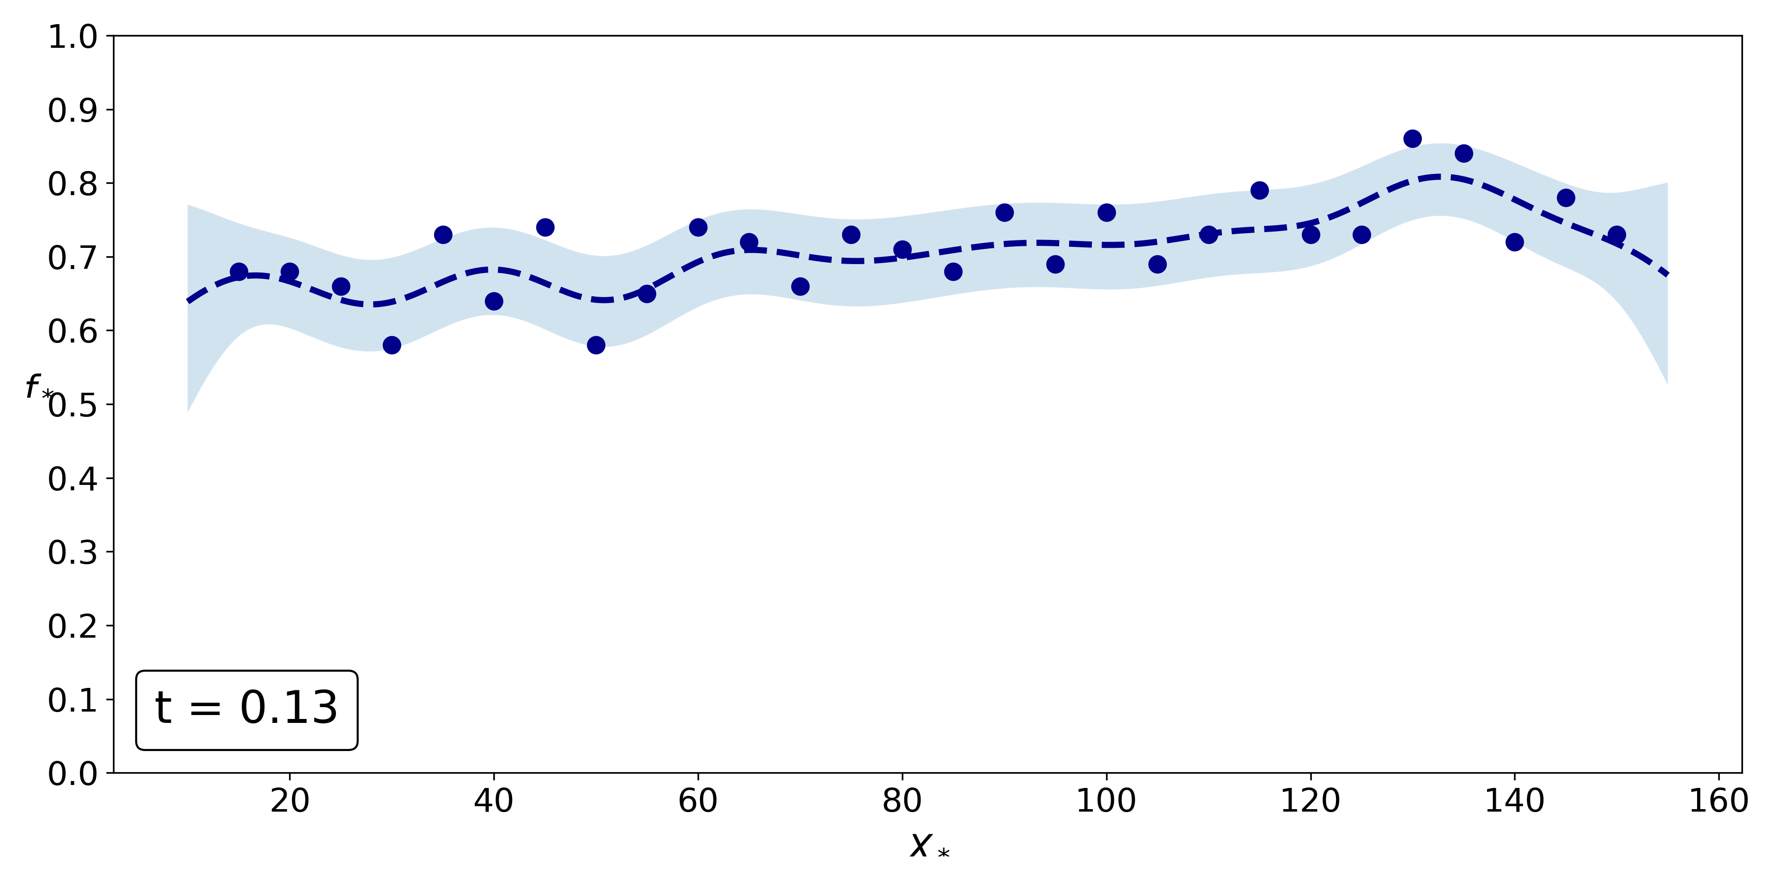
Case Study
Coefficient of Variation
2) Two-Reaction CRN
Infer fitness function with SMMC
$φ$: at least (100 $⋅$ t)% of the colony survives
Analyse satisfaction for different $t∈[0.09,0.23]$ over varying population sizes
Find largest $t$ with $c_{v}<0.1$ to get plausible fitness function
At least 13% survives
SMMC posterior
11/24/2021
Applications of Gaussian Processes in Modelling Biological Collectives

Slide 36
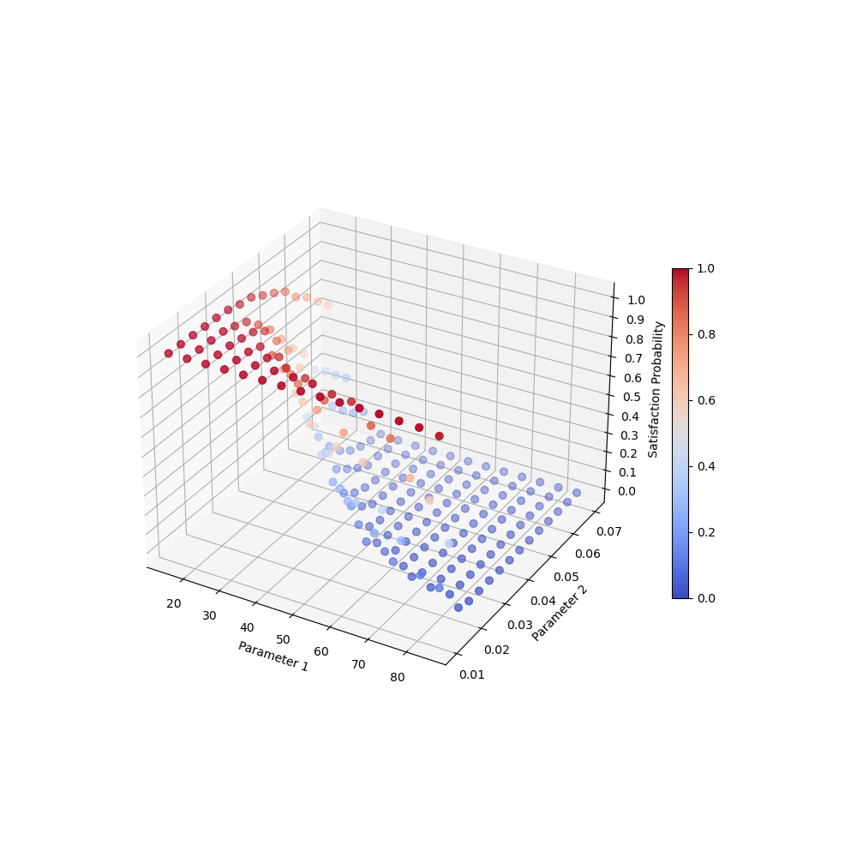
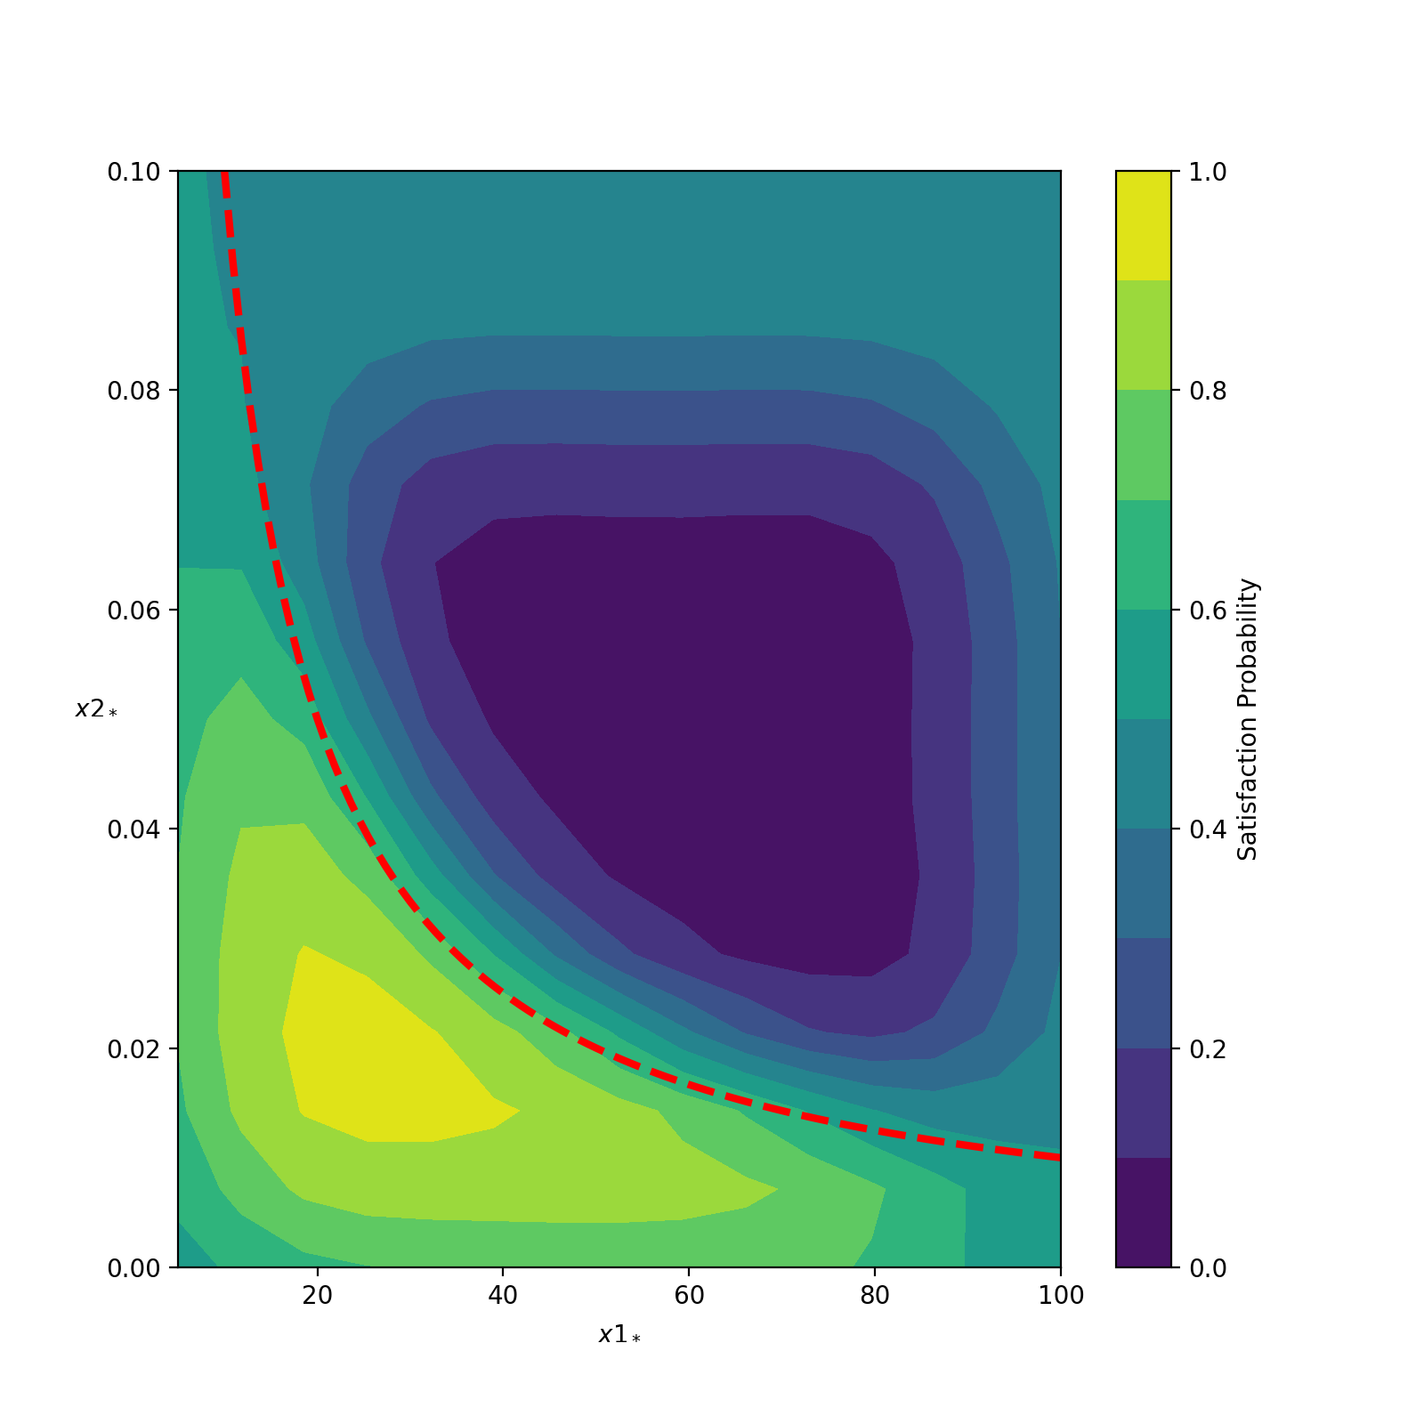
Case Study
Training data
2) Two-Reaction CRN
Find parameter with 2-dim. SMMC
Assume we know that at least 11% survives
Find stinging parameter $k_{1}$ for which fitness function is most robustly satisfied
For $k_{2}=1$, run CRN 1000 times for 15 different rates $k_{1}∈[0.01,0.07]$ and 15 population sizes $N∈[15,85]$
For each case, compute number of runs satisfying $φ$ (at least 11% survives)
Scaling $k_{1}$ by $N$ could not be enough to model desired fitness function
SMMC posterior
11/24/2021
Applications of Gaussian Processes in Modelling Biological Collectives

Slide 37
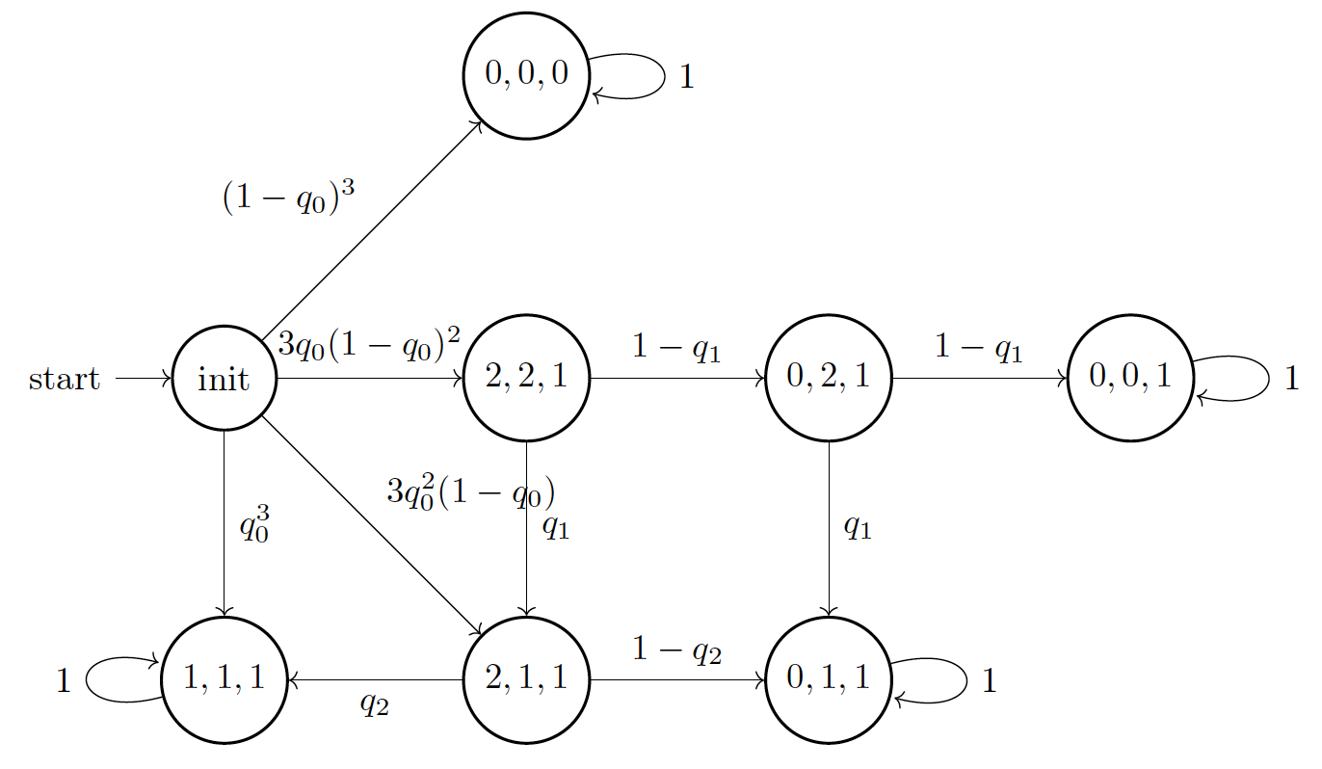
Case Study
3) Parametric DTMC
Parametric population DTMC to model behaviour of three bees
3 parameters $q_{0},q_{1},q_{2}$
4 BSCCs representing final states
0: living bee
1: stinging (dead) bee
Implemented in PRISM
Larger population sizes require new models
State space explosion
Hajnal (2019)
Kwiatkowska (2011)
11/24/2021
Applications of Gaussian Processes in Modelling Biological Collectives

Slide 38
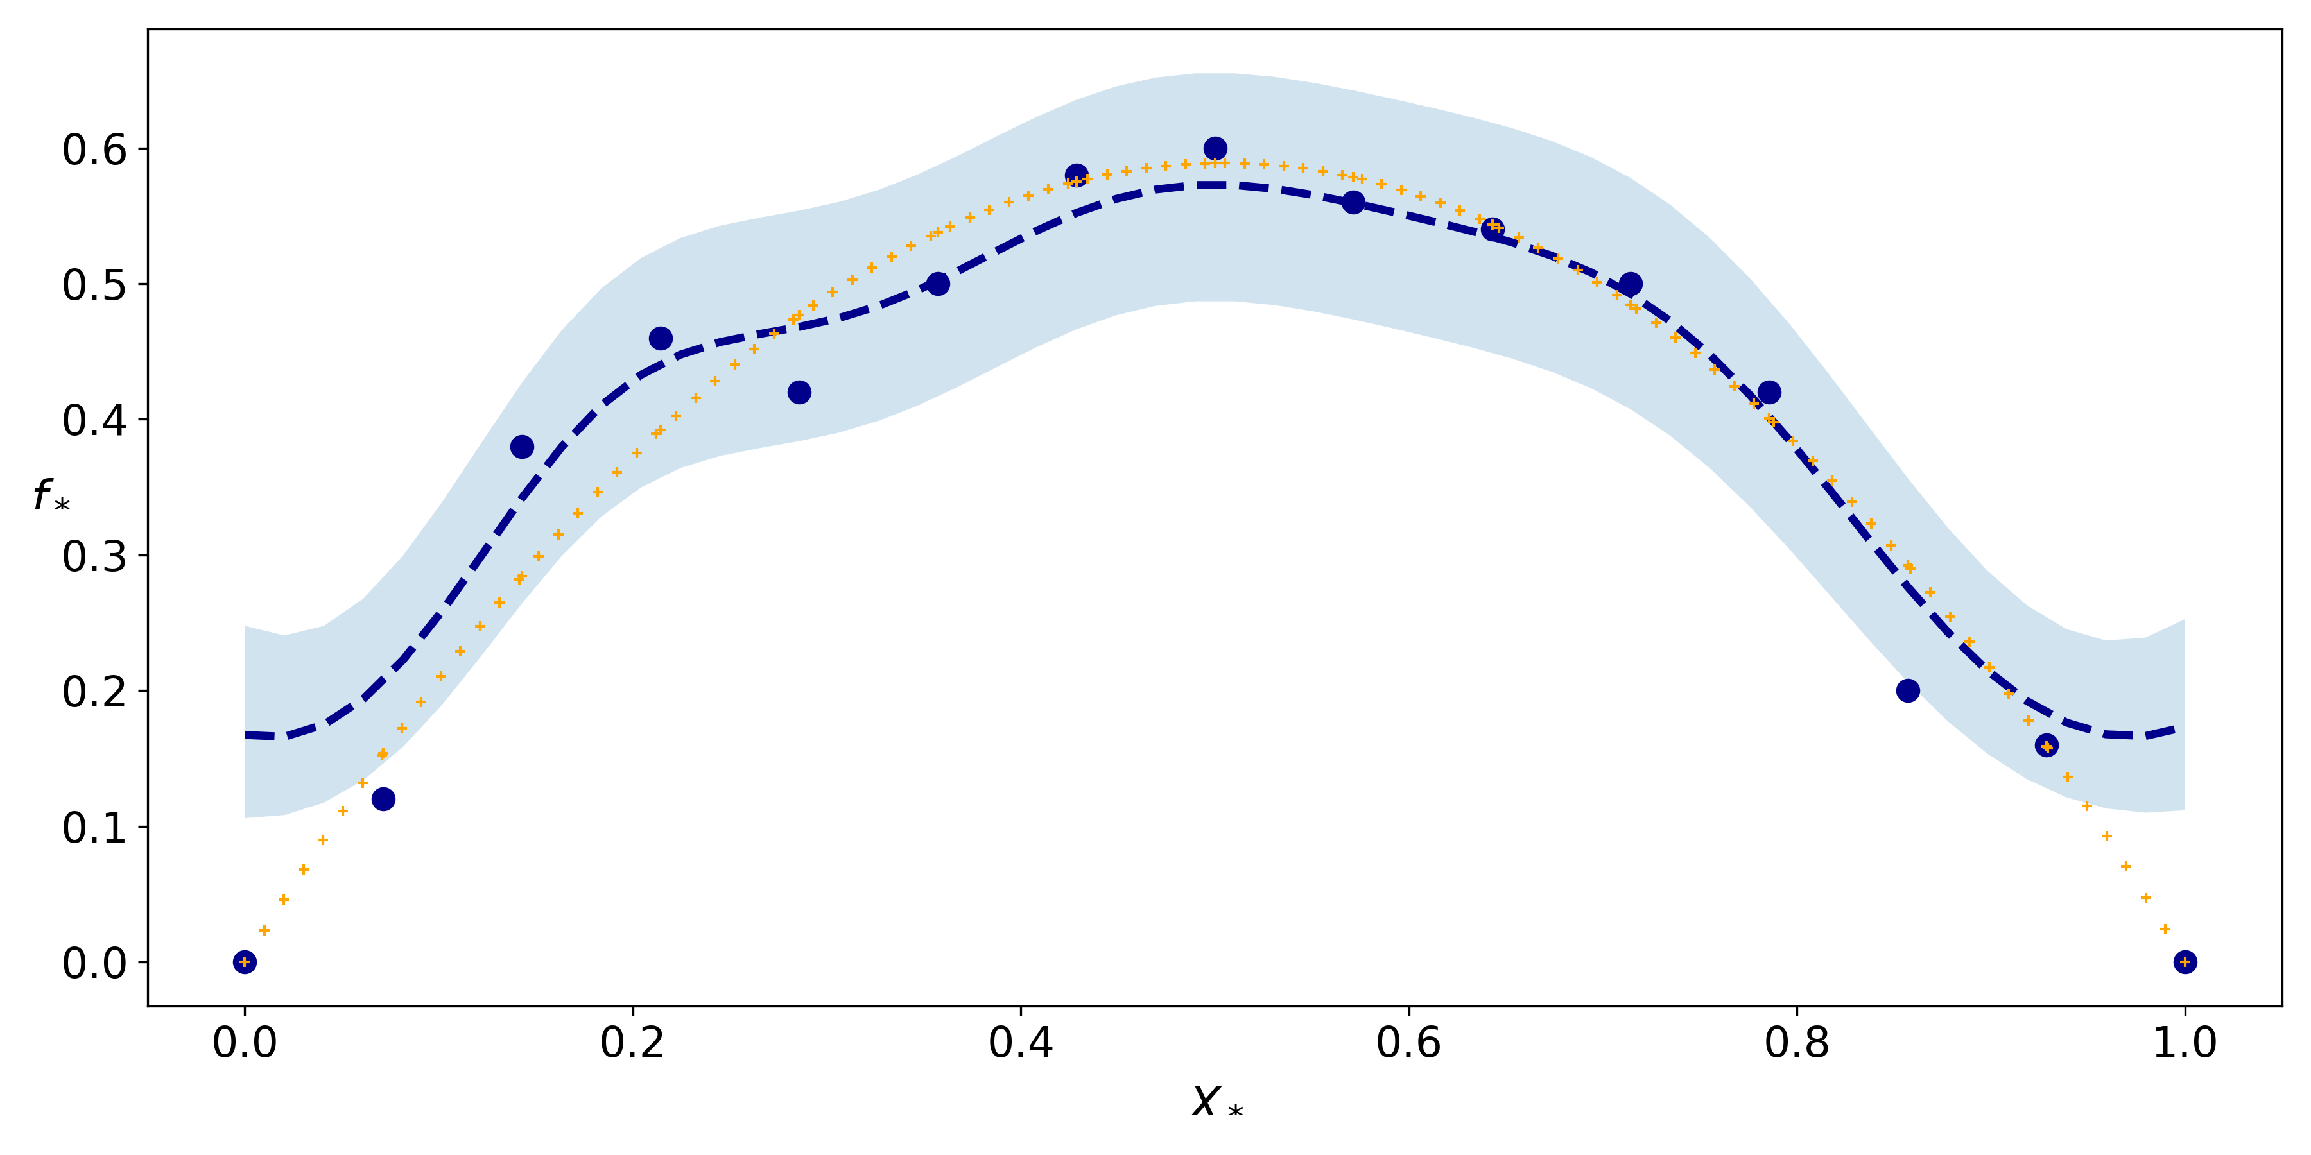
Case Study
3) Parametric DTMC
Find parameter with 1-dim. SMMC
How does value of $q_{0}$ influence the satisfaction probability of $φ:P_{=?}F(0,1,1)$
Fix $q_{1}=0.7,q_{2}=0.2$
Simulate DTMC for 15 values of $q_{0}∈[0,1]$ and generate 50 trajectories for each value
Highest satisfaction probability around $q_{0}=0.5$
Probabilistic model checking of 100 values of $q_{0}∈[0,1]$ confirm result
11/24/2021
Applications of Gaussian Processes in Modelling Biological Collectives

Slide 39
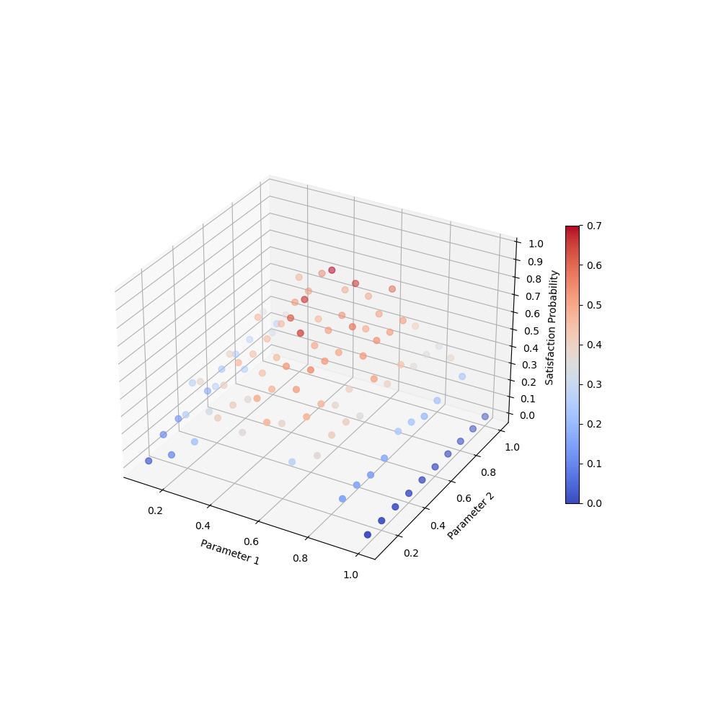
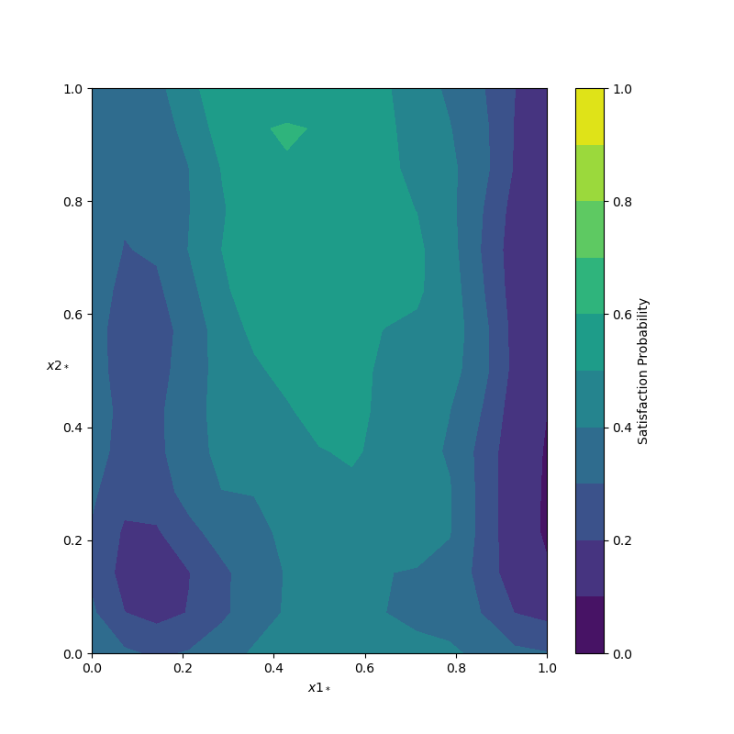
Case Study
3) Parametric DTMC
Find parameters with 2-dim. SMMC
Infer $q_{0}$ and $q_{1}$ such that satisfaction probability of $φ$ is maximised
Fix $q_{2}=0.2$
Simulate DTMC for 10 values of $q_{0}∈[0.1,1]$ and $q_{1}∈[0.1,1]$ and generate 50 trajectories for each combination of values
Highest satisfaction probability around $q_{0}=0.43$ and $q_{1}=0.91$
11/24/2021
Applications of Gaussian Processes in Modelling Biological Collectives

Slide 40
Discussion
Conclusions
Prediction of collective response
Validation shows good results
No need for new experiments
Inference of fitness function
Smooth satisfaction function over uncertain parameter
Coefficient of variation provides estimate to select most plausible fitness function
Parameter inference
Find parameter to get stable satisfaction probabilities across population sizes
Design model to satisfy property → exhibit desired behaviour
11/24/2021
Applications of Gaussian Processes in Modelling Biological Collectives
Notes:
Combining: flexibility of ML together with guarantees and a data-driven method to get reliable results with few data
More distant future

Slide 41
Discussion
Conclusions
GPR/GPC is powerful to make predictions & quantify uncertainty
Combining Formal Methods with Machine Learning seems promising
SMMC faster and more accurate than standard statistical model checking tools
Reliable results for scarce data
Wide applicability
Different contexts (data, model)
Different research questions
Apply GPR to any measurable entity
Apply SMMC to any verifiable property
11/24/2021
Applications of Gaussian Processes in Modelling Biological Collectives
Notes:
Combining: flexibility of ML together with guarantees and a data-driven method to get reliable results with few data
More distant future

Slide 42
Discussion
Limitations
Restricted interpretation for predicting mean and variance of histogram
Collect more data to get better results
Predictions outside the range of parameters are difficult
No guarantee that Expectation Propagation converges
Optimise hyperparameters in SMMC
11/24/2021
Applications of Gaussian Processes in Modelling Biological Collectives
Notes:
Combining: flexibility of ML together with guarantees and a data-driven method to get reliable results with few data
More distant future

Slide 43
Discussion
Future Work
Introduce weighing factor for more/less relevant value ranges
Improve automatic learning of parameters of the model
Learn fitness function from data
Learn structure of the model from data
11/24/2021
Applications of Gaussian Processes in Modelling Biological Collectives
Notes:
Combining: flexibility of ML together with guarantees and a data-driven method to get reliable results with few data
More distant future

Slide 44
References
Luca Bortolussi, Dimitrios Milios, and Guido Sanguinetti. Smoothed model checking for uncertain continuous-time Markov chains. Information and Computation, 247:235–253, 2016.
Matej Hajnal, Morgane Nouvian, David Šafranek, and Tatjana Petrov. Data- Informed Parameter Synthesis for Population Markov Chains. In International Workshop on Hybrid Systems Biology, pages 147–164, Cham, 2019. Springer. doi: 10.1007/978-3-030-28042-0_10.
Marta Kwiatkowska, Gethin Norman, and David Parker. PRISM 4.0: Verification of probabilistic real-time systems. In International conference on computer aided verification, pages 585–591, Berlin, Heidelberg, 2011. Springer.
Frederico Pimentel Gomes. Curso de estatística experimental. Nobel, Sao Paulo, 13 edition, 2000.
Denis Repin, Nhat-Huy Phung, and Tatjana Petrov. StochNetV2: A Tool for Automated Deep Abstractions for Stochastic Reaction Networks. In International Conference on Quantitative Evaluation of Systems, pages 27–32, Cham, 2020. Springer.
Carl Edward Rasmussen and Christopher K. I. Williams. Gaussian processes for machine learning, volume 2 of 3. MIT Press, Cambridge, MA, 2006.
11/24/2021
Applications of Gaussian Processes in Modelling Biological Collectives

Slide 45
11/24/2021
Applications of Gaussian Processes in Modelling Biological Collectives

